Slide 1
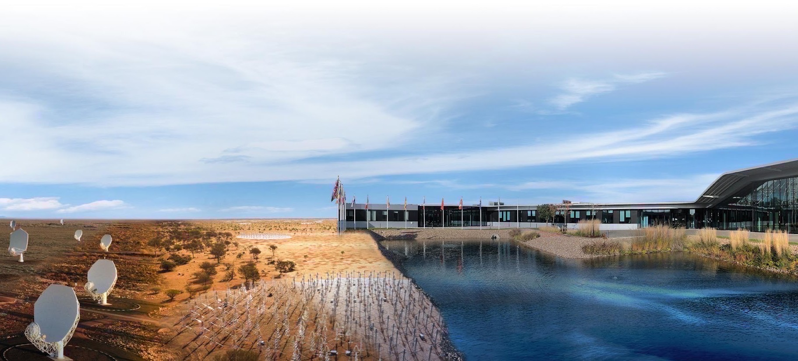
Radio Astronomy Made Easy:
Build DIY Radio Telescopes and
Observe with an Intuitive GUI
Shin’ichiro Asayama (SKAO)
7 September 2025

Slide 2
Radio Astronomy with commercially available equipment

Slide 3
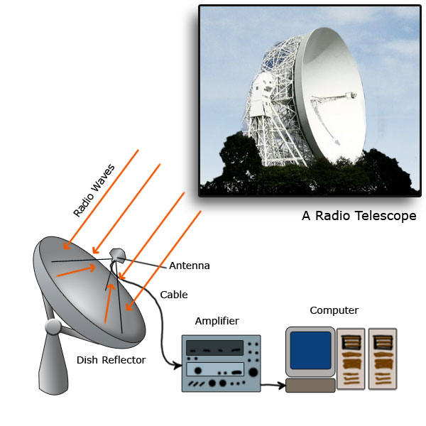

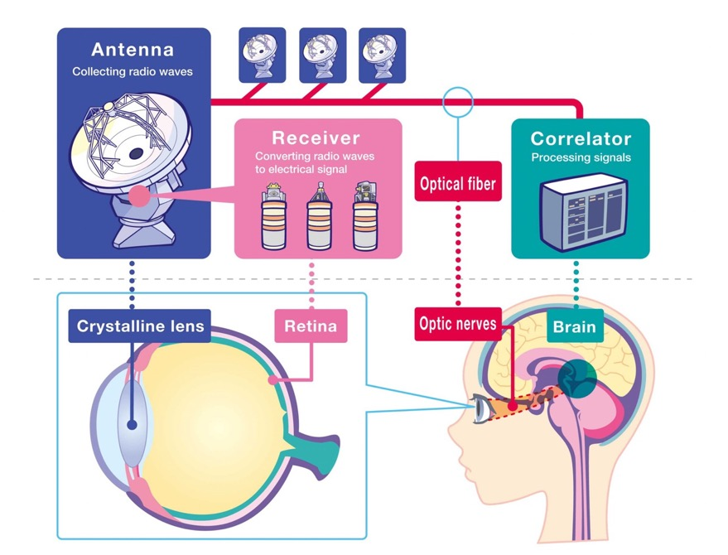
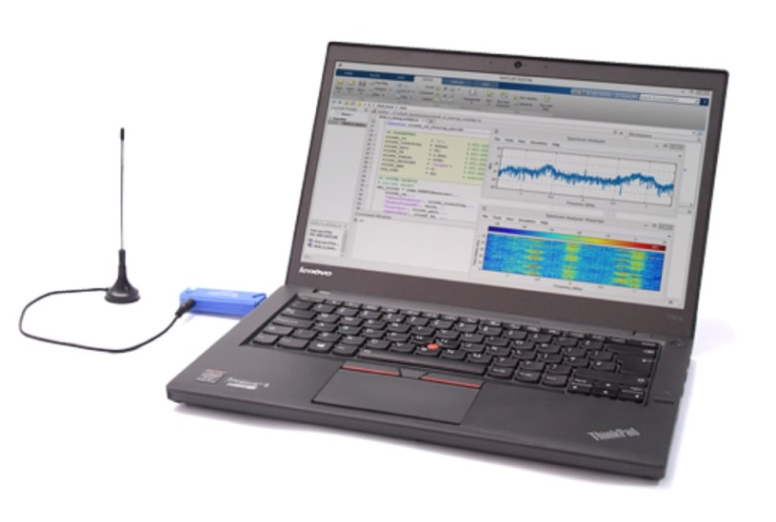
Radio Astronomy with commercially available equipment
Recent advancements in Information and communications technology (ICT) have enabled us to enjoy Radio Astronomy with commercially available equipment.
3

Slide 4
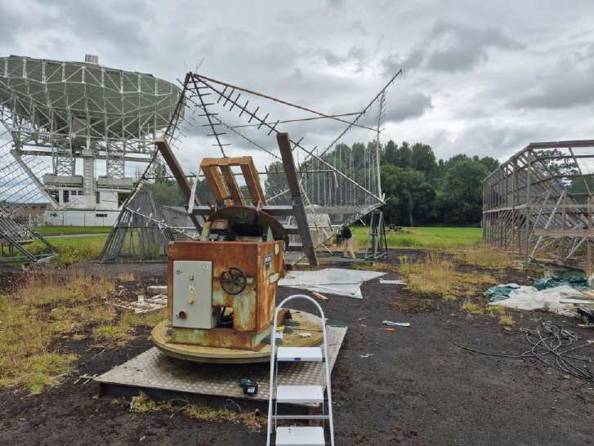
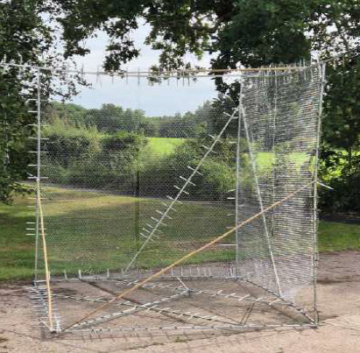
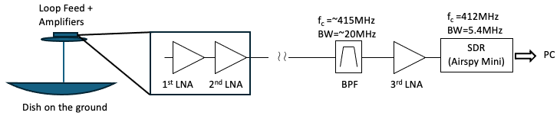
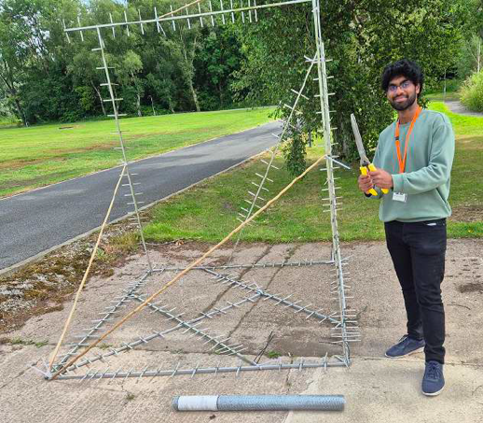
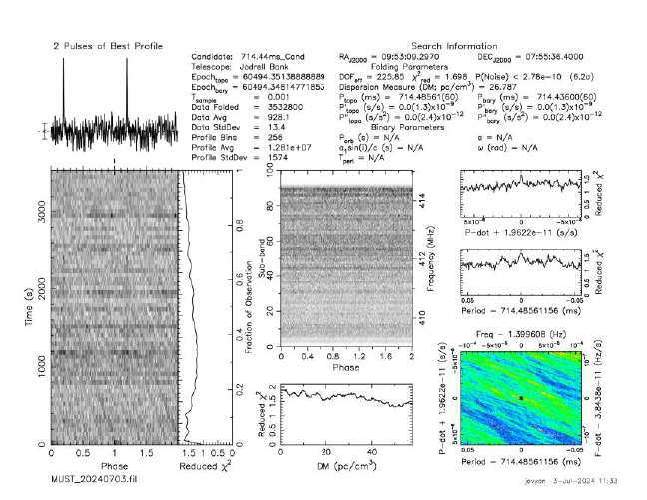
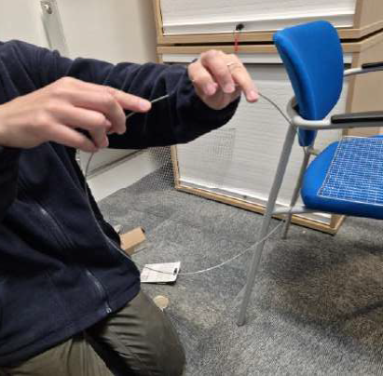
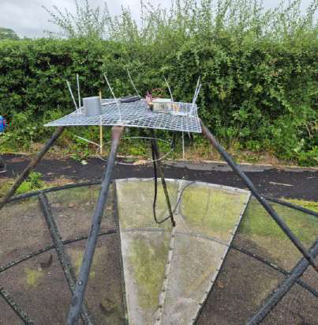
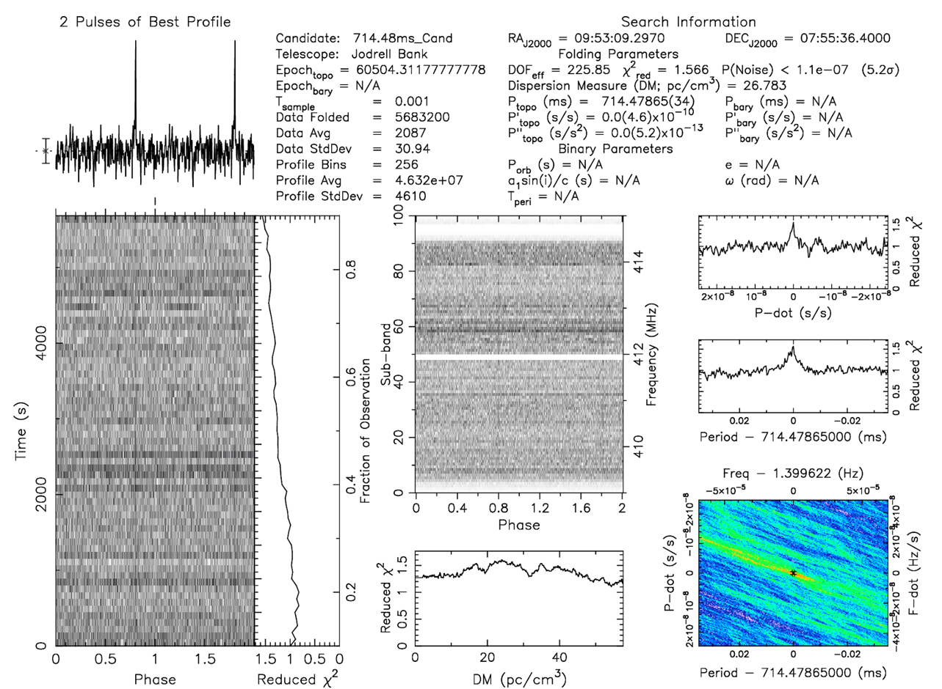
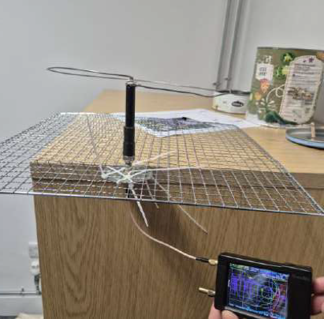
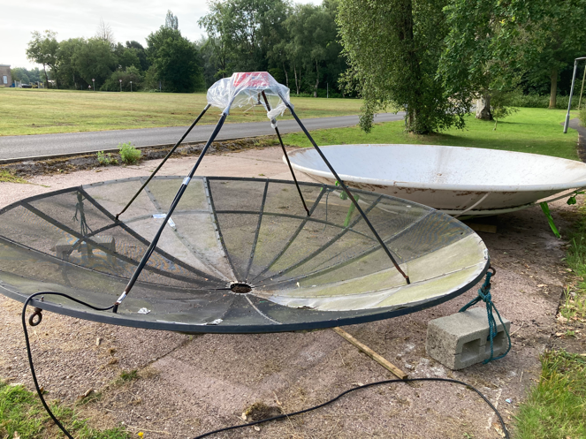
Pulsar Detection Capability at SKAO HQ with Handmade instrument
Handmade 3D corer reflector results
The brightest pulsar visible in the northern hemisphere (PSR B0329+54) was detected with both the handmade loop feed installed on the mesh dish and the handmade 3D corner reflector.
See the recording of Shriram’s talk: https://confluence.skatelescope.org/display/SKAQA/SKAO+Speaker+Series
Handmade loop Feed
Shriram Vijaysampath
Student: Physics with Astrophysics at the University of Warwick

Slide 5
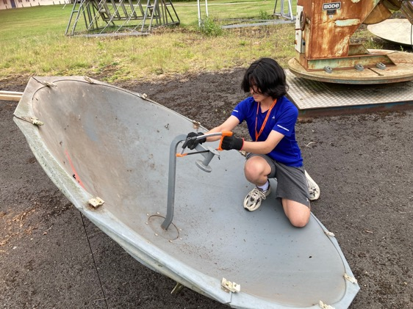
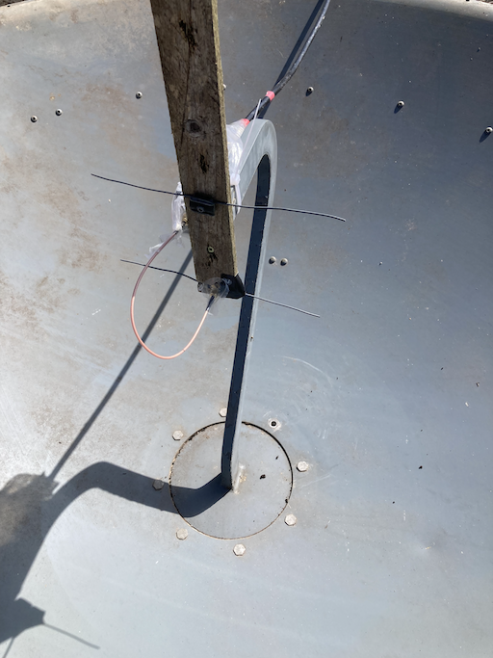
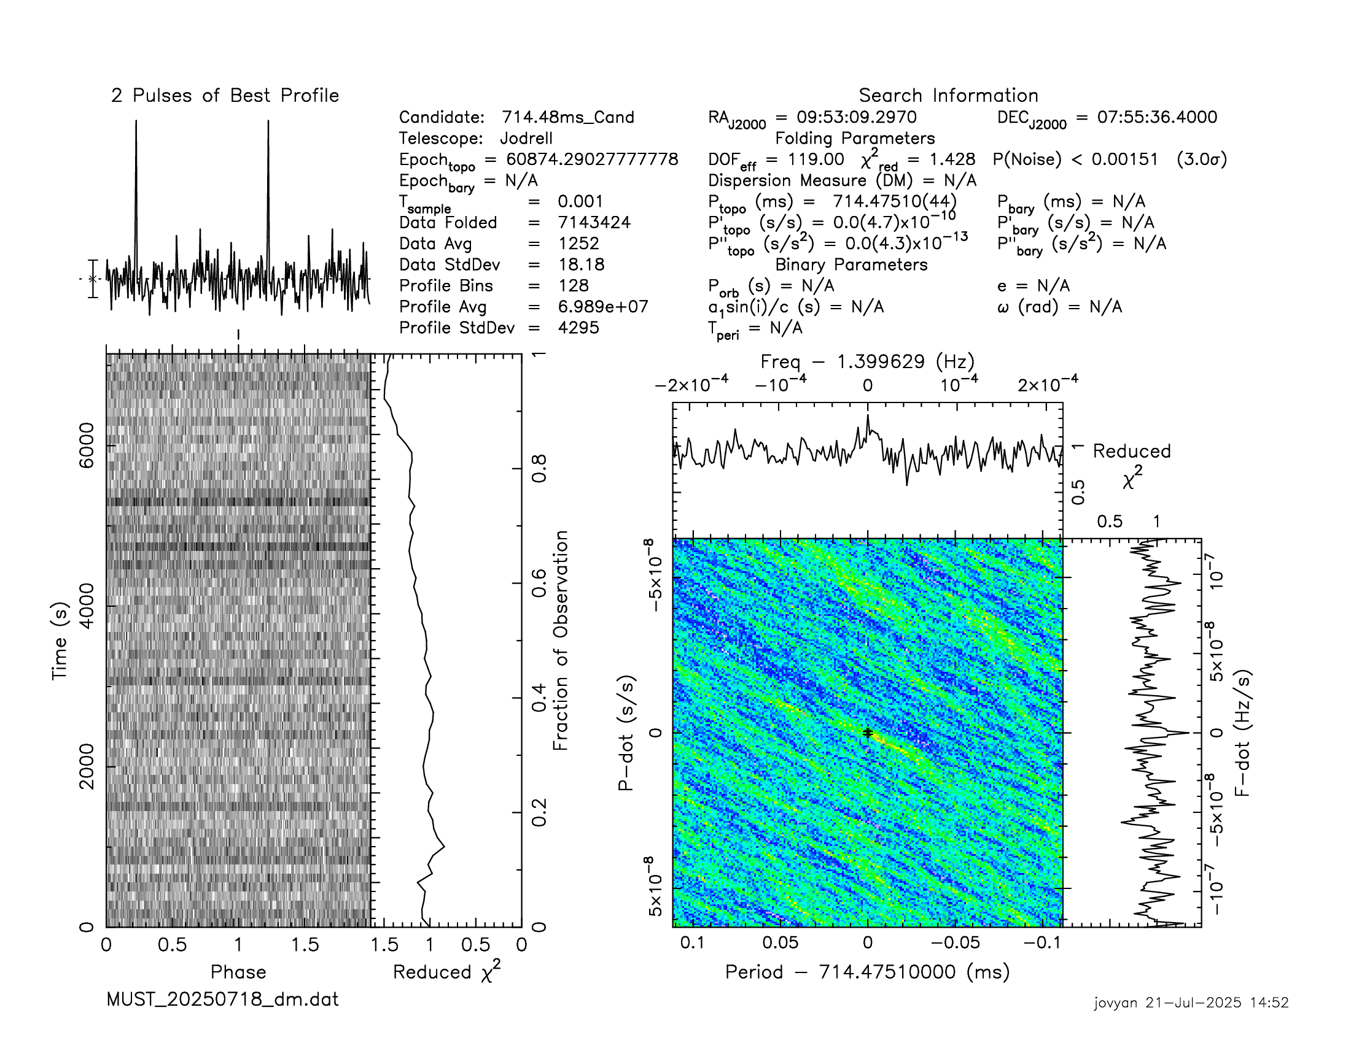
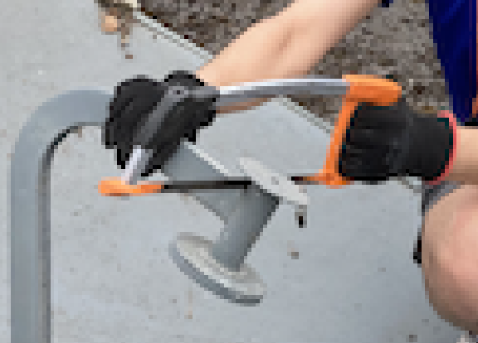
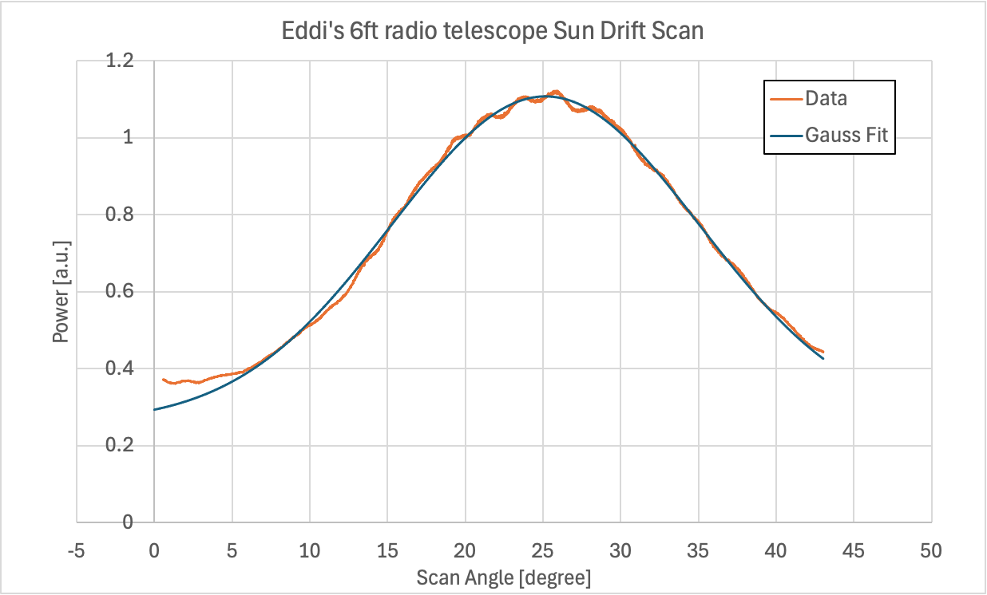
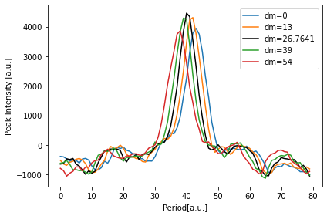
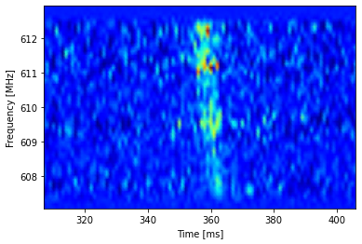
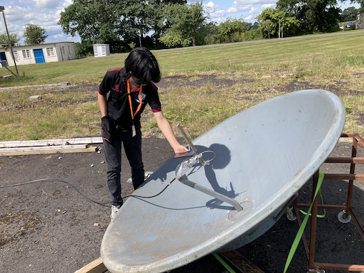

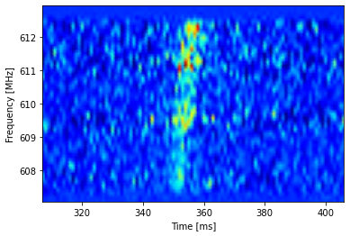
Deployment of 6ft Deep dish(f/D~0.25) @610 MHz by a High school Student
The brightest pulsar visible in the northern hemisphere (B0329+54) was detected at 610MHz.
Rod
reflector
Dipole
A hacksaw is all you need!
15-day integrated pulse in July 2025
DM=0
DM=26.7641
Measured FWHM ~ 23 deg @610MHz
DM=54

Slide 6
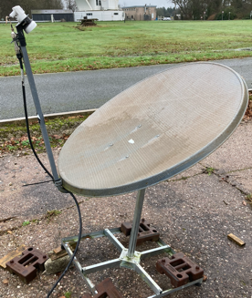
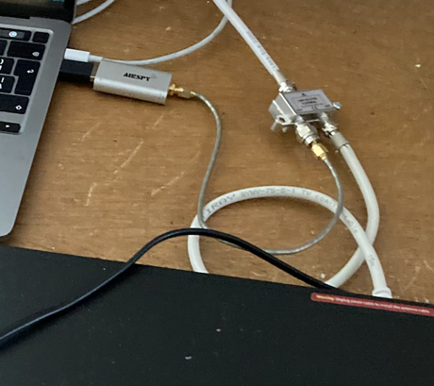
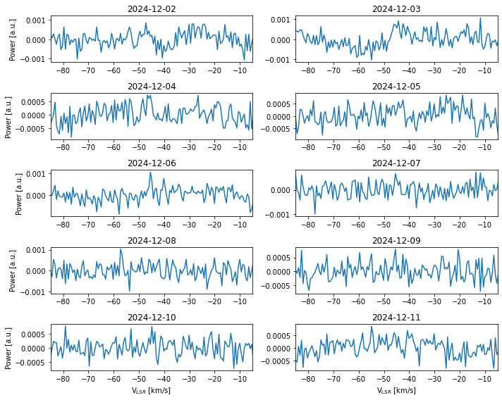
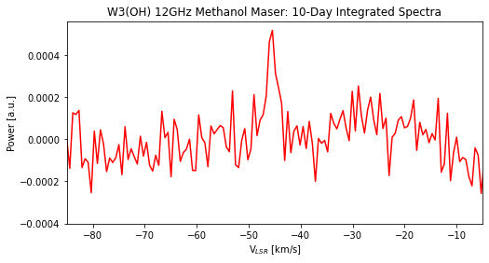
W3(OH)12.2 GHz Methanol Maser Detection with a 1m satellite Dish
2 Way Satellite
Cable Splitter
A cheap Low-Noise Block (LNB) (< £10 ☺)
Satellite TV receiver to provide DC power and a 22kHz tone for the LNB to activate “high band” (LO=10.6GHz).
The LNB LO offset was checked with Astra 3B satellite beacon at 11446.7266 MHz.
Data was recorded with Airspy mini SDR (BW = 6MHz).
Daily V_{LSR} correction was done using Astropy.
Airspy
mini
DC+
22kHz
tone
IF=1.58GHz
Set the dish at the declination of W3(OH) and let the target drift through the beam daily – Patience is needed!!
W3(OH) 10 days of observations
Satellite TV receiver
Reference:
Project EM01: Mini maser telescope: detecting 12.2 GHz methanol masers with a 1-metre dish http://parac.eu/projectem01.htm

Slide 7
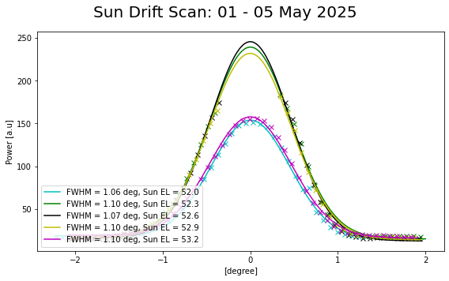
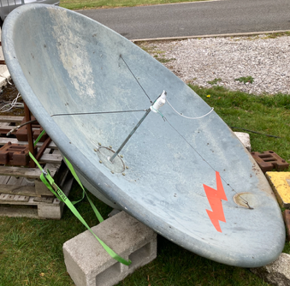
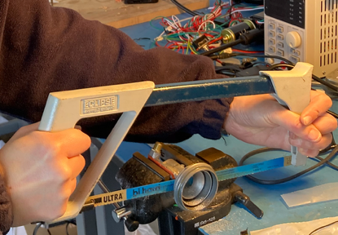
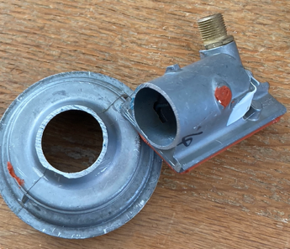
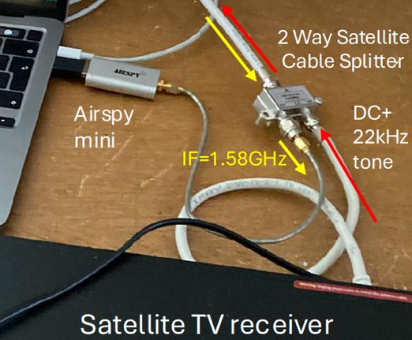
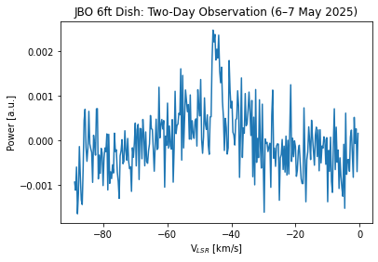
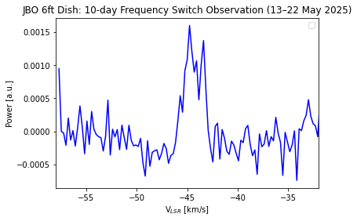
6ft Dish (F/D~0.25) Assembly, Integration, Verification and Commissioning (AIVC)
LNB (Low-Noise Block) Modification
Science Verification and Commissioning
An open-ended circular waveguide with a diameter just above the cutoff dimension is well-suited for a very deep dish (F/D ~ 0.25).
Optimisation of focus and determination of beam offsets using the Sun.
A hacksaw is all you need!
Assembly, Integration and Validation (AIV)
Satellite TV receiver to provide DC power and a 22kHz tone for the LNB to activate “high band” (LO=10.6GHz).
The LNB LO offset was checked with Astra 3B satellite beacon at 11446.7266 MHz.
W3(OH)12.2 GHz Methanol Maser Detection
Set the dish at the declination of W3(OH) and let the target drift through the beam daily.
~10 min
ON/OFF
2-days
~10 min
Frequency
Switch
10-days

Slide 8
Detection of Hydrogen 21cm emission line using inexpensive/commercially available equipment

Slide 9
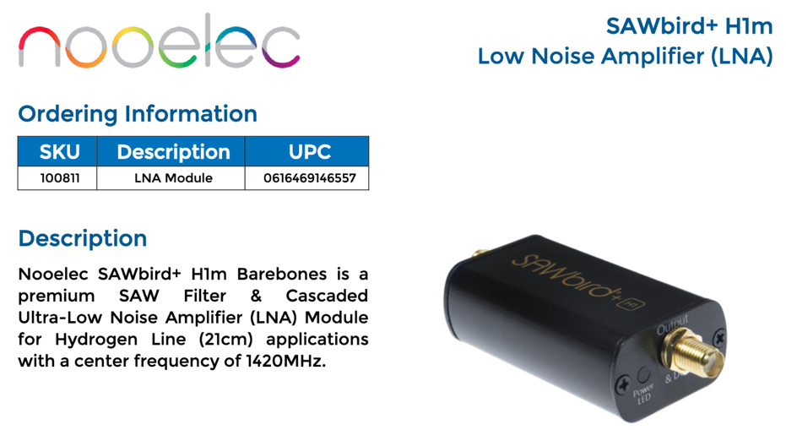
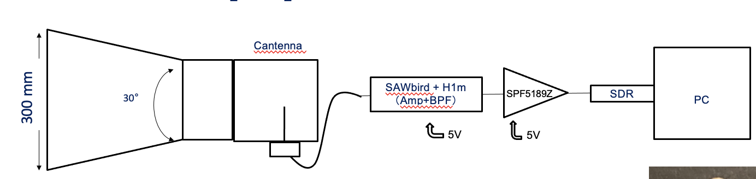
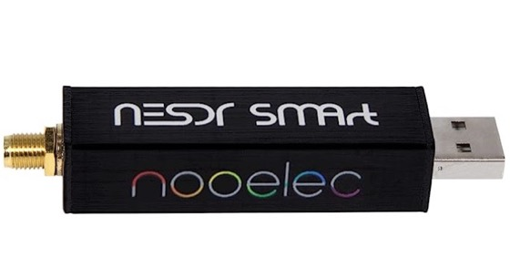
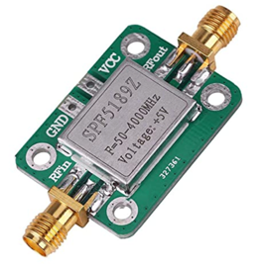
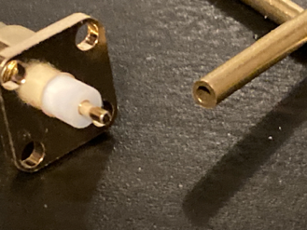

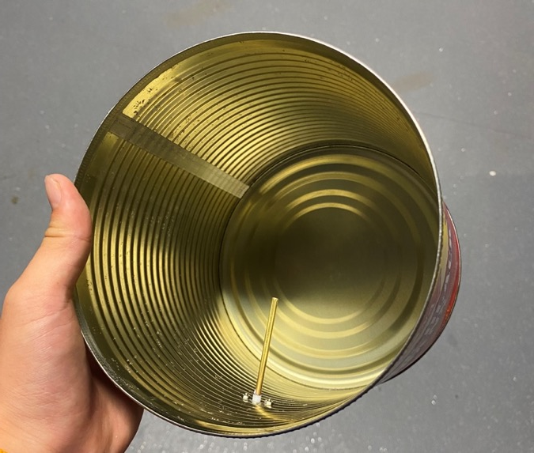
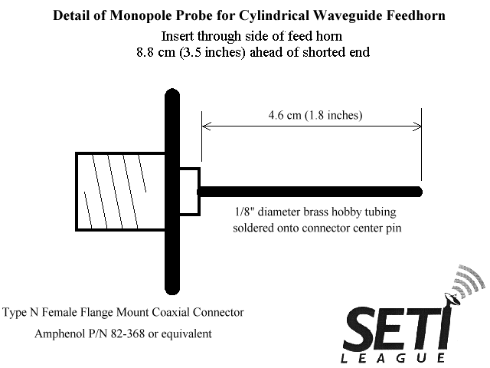
Detection of Hydrogen 21cm emission line using inexpensive/commercially available equipment
Freq = | 1.42 | GHz
Waveguide Diameter = | 15.8 | cm
TE11 Cutoff = | 27.0 | cm
TM01 Cutoff = | 20.7 | cm
Probe placement = | 8.5 | cm
Feedhorn Length = | 25.5 | cm
http://www.setileague.org/hardware/feedchok.htm
9

Slide 10
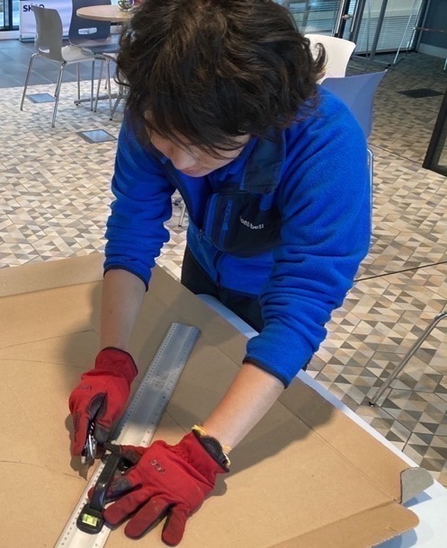
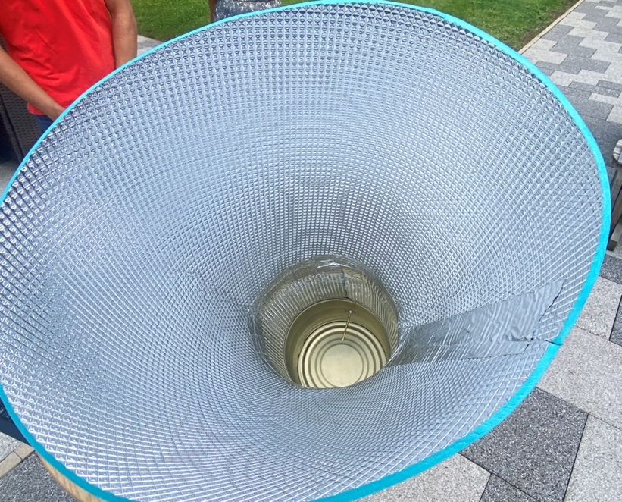
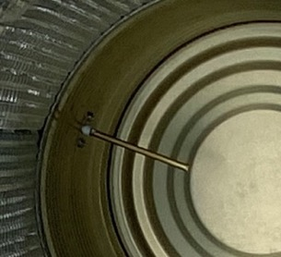
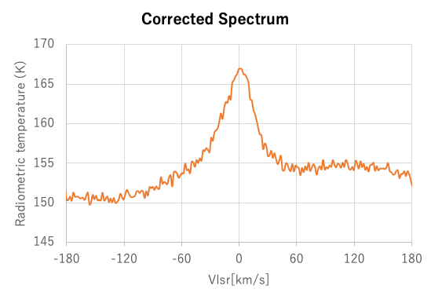
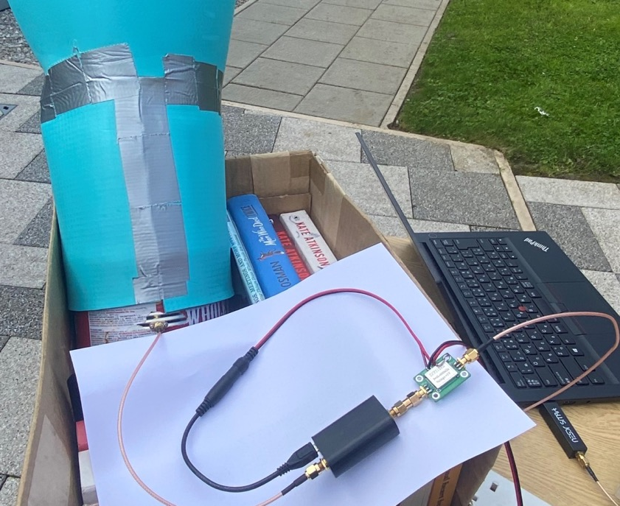
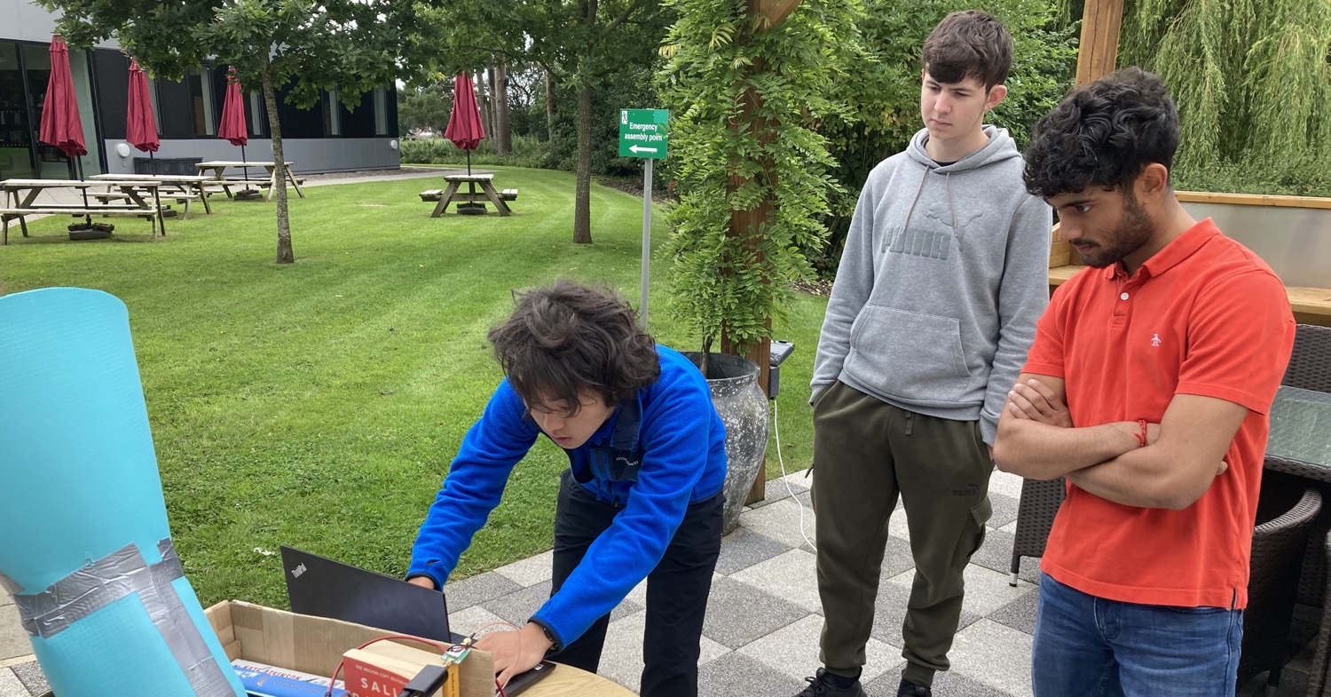
High School Student
Riku’s Camping Mat horn antenna
Horn
Antenna
Cantenna
Amp
SDR
SAWbird+ H1
10

Slide 11
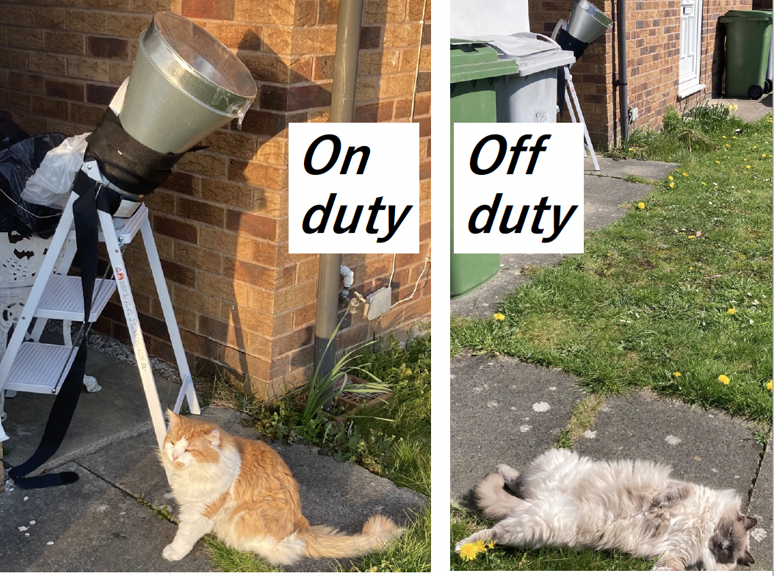
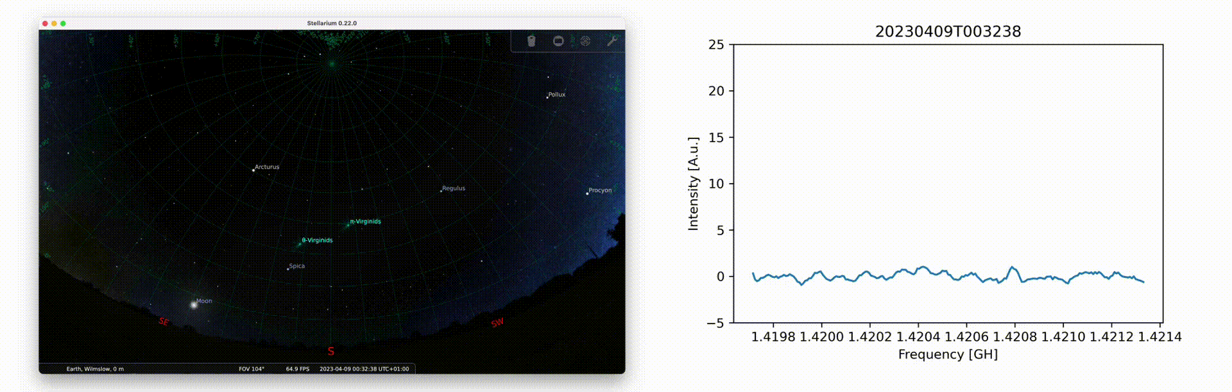
Time-lapse
Need good operators (Cats!)☺

Slide 12
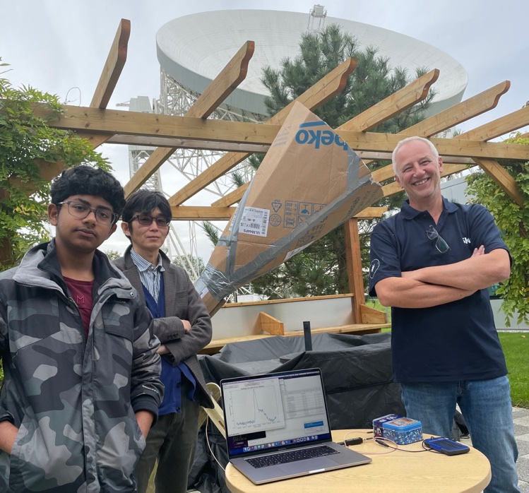





Exploring Galactic Rotation Curve with a 2.5-ft Telescope:
A Work Experience Project
Lovell Telescope
250ft
(76.2 m)
Telescope positioning was with iPhone's Compass and Level (~5$°$ accuracy). Although rough pointing directions, the measured hydrogen line profiles reasonably agree with the professional hydrogen line profiles.
150km/s
125km/s
100km/s
The expected profiles (Orange dashed lines) downloaded from:
Argelander-Institut furAstronomie (University of Bonn)
75km/s
50km/s
With rough velocity determination by eye, the rotation curve of the galaxy were derived using the tangent point method. The flat Galactic rotation curve can be seen. This suggests that the mass distribution of the Galaxy is not uniform, and that there is some unseen matter that affects the orbital speeds of stars and gas.
2.5ft
(76.2cm)

Slide 13





Workshop building SKAO Table-top Radio Telescopes (TTRT)
Students in Görlitz 🇩🇪 built tabletop radio telescopes with DZA and observed the Milky Way.

Slide 14




SKAO TTRT Outreach Highlights at IAU GA in Cape Town
SKAO’s TTRT captivated audiences at the International Astronomical Union General Assembly (IAU GA) with hands-on demos and educational sessions.
The outreach extended to three Cape Town universities, Stellenbosch, and University of Western Cape.
A further session was staged for younger children at the Cape Town Science Centre.

Slide 15
A totally nutty radio telescope—because why not?

Slide 16


Science influencer
Big Manny’s Balloon Horn Antenna
16

Slide 17






Cat Tunnel Radio Telescope
Cat tunnel
Horn antenna
(Template)
Pop the cat tunnel over the horn,
bend the wire to shape it,
and snip off any extra fabric to make it fit!
17

Slide 18





Bird Feeder Radio Telescope

Slide 19






Portable Mini Umbrella Hat
Radio Telescope
Enjoy Cookies
2. Make a loop feed with the tin lid
3. Glue tin foil over the Umbrella Hat
4. Fix the loop feed on the umbrella hat with the headband.
19

Slide 20





BBQ Grill Net Radio Telescope
Brass Round
Tube 3mm
Plastic
Cable
Ties
BBQ Grill Mesh ~30cm
SMA
Connector
Brass Round
Tube
Monopole ~ 15.5cm
Dia. ~3mm
SDR
DC5V
from USB
~12.5cm
SAWbird+ H1 +
Amp
~12.5cm
BBQ Nets are assembled with cable ties
SMA Connector is
attached with cable ties
20

Slide 21









Paper Craft
Radio Telescope
Wrap cardboard around the plastic bottle to adjust the column's thickness.
Attach the helical antenna to the column built in step 7.
Connect the centre pin of the SMA connector to the helical antenna using tin foil and secure it with tape. Use a tester to check the electrical connectivity between the top of the helical antenna and the centre sleeve of the SMA connector
Print the template at 100% or actual size on A3 paper. Do not scale.
Make a circular column by rolling the template and tape or glue it.
Twist tin foil into a string, wrap it around the guide, and secure it with tape to create a helical antenna
Use a circular board larger than 20 cm (such as candy lids) and 500 ml plastic bottles
Glue tin foil to the lid as a ground plane, drill a hole in the centre of the lid for the bottle opening and attach the bottle to the lid using the plastic bottle cap.
SMA
connector
Centre pin of the SMA connecter
Attach an SMA connector to the lid using screws, washers, and nuts.
Use a tester, such as a multimeter, to check the electrical connectivity between the ground plane and the SMA connector.
Bottle
Cap
Use metal washers for electrical connections.
21

Slide 22


SKAO TTRT Windows App Demo
https://gitlab.com/ska-telescope/ska-tabletop-radiotelescope/-/packages/40199961

Slide 23




HI Observation Software for Windows
Setting up an observation environment posed a significant barrier for general users.
To facilitate HI observations, SKAO has developed a dedicated application for Windows PCs.
Thanks to this new application, the number of successful observations has increased markedly.

Slide 24


SKAO Windows App Demo
RF
Termination
24

Slide 25


SKAO Windows App Demo
25

Slide 26
Thank you!

Slide 27





The 21 cm Spectral Line of Neutral Hydrogen
Because of the motion of the emitting atoms relative to the observer the hydrogen line does not appear at a single frequency but is spread out and shifted from its “rest” frequency of 1420.406 MHz. The spread is due to random motions within a cloud of gas and the shift is due to the overall or “bulk” motion of the cloud itself. The non-relativistic Doppler shift formula:
if 𝒇_{𝒐𝒃𝒔} is below 𝒇_{𝒆𝒎} the gas is moving away from the observer (receding) and the radial velocity is said to be positive
if 𝒇_{𝒐𝒃𝒔} is above 𝒇_{𝒆𝒎} the gas is moving towards the observer (approaching) and the radial velocity is said to be negative
27

Slide 28








Japanese Earth-Moon-Earth (EME)
Communication Antenna
Period Check
The diurnal and annual doppler shift of the period on B0329+54 due to the daily rotation of the Earth and its annual orbit around the sun.
DM Check

Slide 29





Kitchenware Radio Telescope Characteristics
OpenMoM Model
The kitchenware radio telescope is a 3D corner reflector with a 30 cm (~1.5λ) on each edge.
The 3D corner reflector antenna was modelled in the OpenMOM.
A matching circuit for a 3D reflector antenna is often needed, but the antenna can match 50ohm at a specific frequency. This can be seen in measuring the real antenna's return loss by finding the optimal point of the position of the monopole.
The calculated gain of the 30cm 3D corner reflector is about 14.8 dBi.
30cm
Monopole ~ 16cm
Dia. ~2mm
~12.5cm
~12.5cm
30cm
30cm
Reference
http://on5au.be/content/a10/vhf/3c.html
https://blog.freifunk-mainz.de/wp-content/uploads/2013/08/Shortened-3D-Corner-Reflector-Antenna.pdf
http://emoss.starfree.jp/OpenMOM/index.html

