Slide 1
Murmur
A Predictive Tool for Pulsar Detectability
EUCARA 2025
Mario Armando Natali
mario.natali@gmail.com
Eucara 2025 Conference, Harwell 6th-7th September
Impedimentum pro occasione arripere
Mario Armando Natali

Slide 2
Murmur
…. Why ??
In 2017, as retirement approached, I began a project to install a 5-meter dish for Earth–Moon–Earth (EME) communications ( … a "Keep Alzheimer Away" (KAA) project ). Around the same time, meeting with Professor Joseph Hooton Taylor ( K1JT ) moved the things further focusing the attention more and more on weak signals techniques.
In 2018, I had the privilege of visiting the Sardinia Radio Telescope ( SRT ), where interactions with leading pulsar radio astronomers triggered a decisive transition toward pulsar radio astronomy.
Alea iacta est — the die was cast ...
Eucara 2025 Conference, Harwell 6th-7th September
Impedimentum pro occasione arripere
Mario Armando Natali

Slide 3

Murmur
…. Why ??
However, the emission from the pulsar is extremely weak and, on top of that, it does not constitute a “ signal ” in the conventional sense but rather manifests itself as broadband noise.
The “signal” ( flux ) is measured in Jansky ( Jy ).
At 1296 MHz, EME communication incurs ≈ 270 dB path loss, yielding ≈ 3,000 Jy ( over 3 kHz ) for bounced signal with 1 W Effective Isotropic Radiated Power ( EIRP ) …
In contrast, pulsars reach peak flux densities of ~1 Jy, with most sources in the mJy range.
Pulsars are almost murmuring :
… do we actually have “ears” good enough to hear?
… MURMUR was born !
Eucara 2025 Conference, Harwell 6th-7th September
Impedimentum pro occasione arripere
Mario Armando Natali

Slide 4
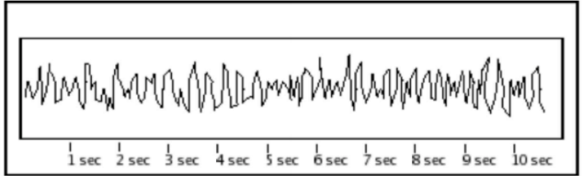
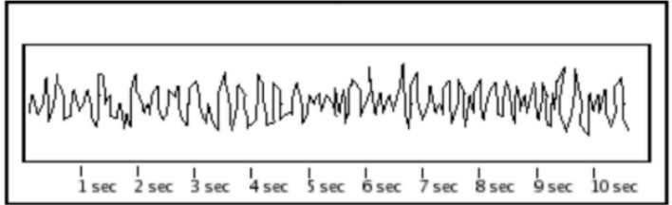

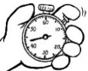
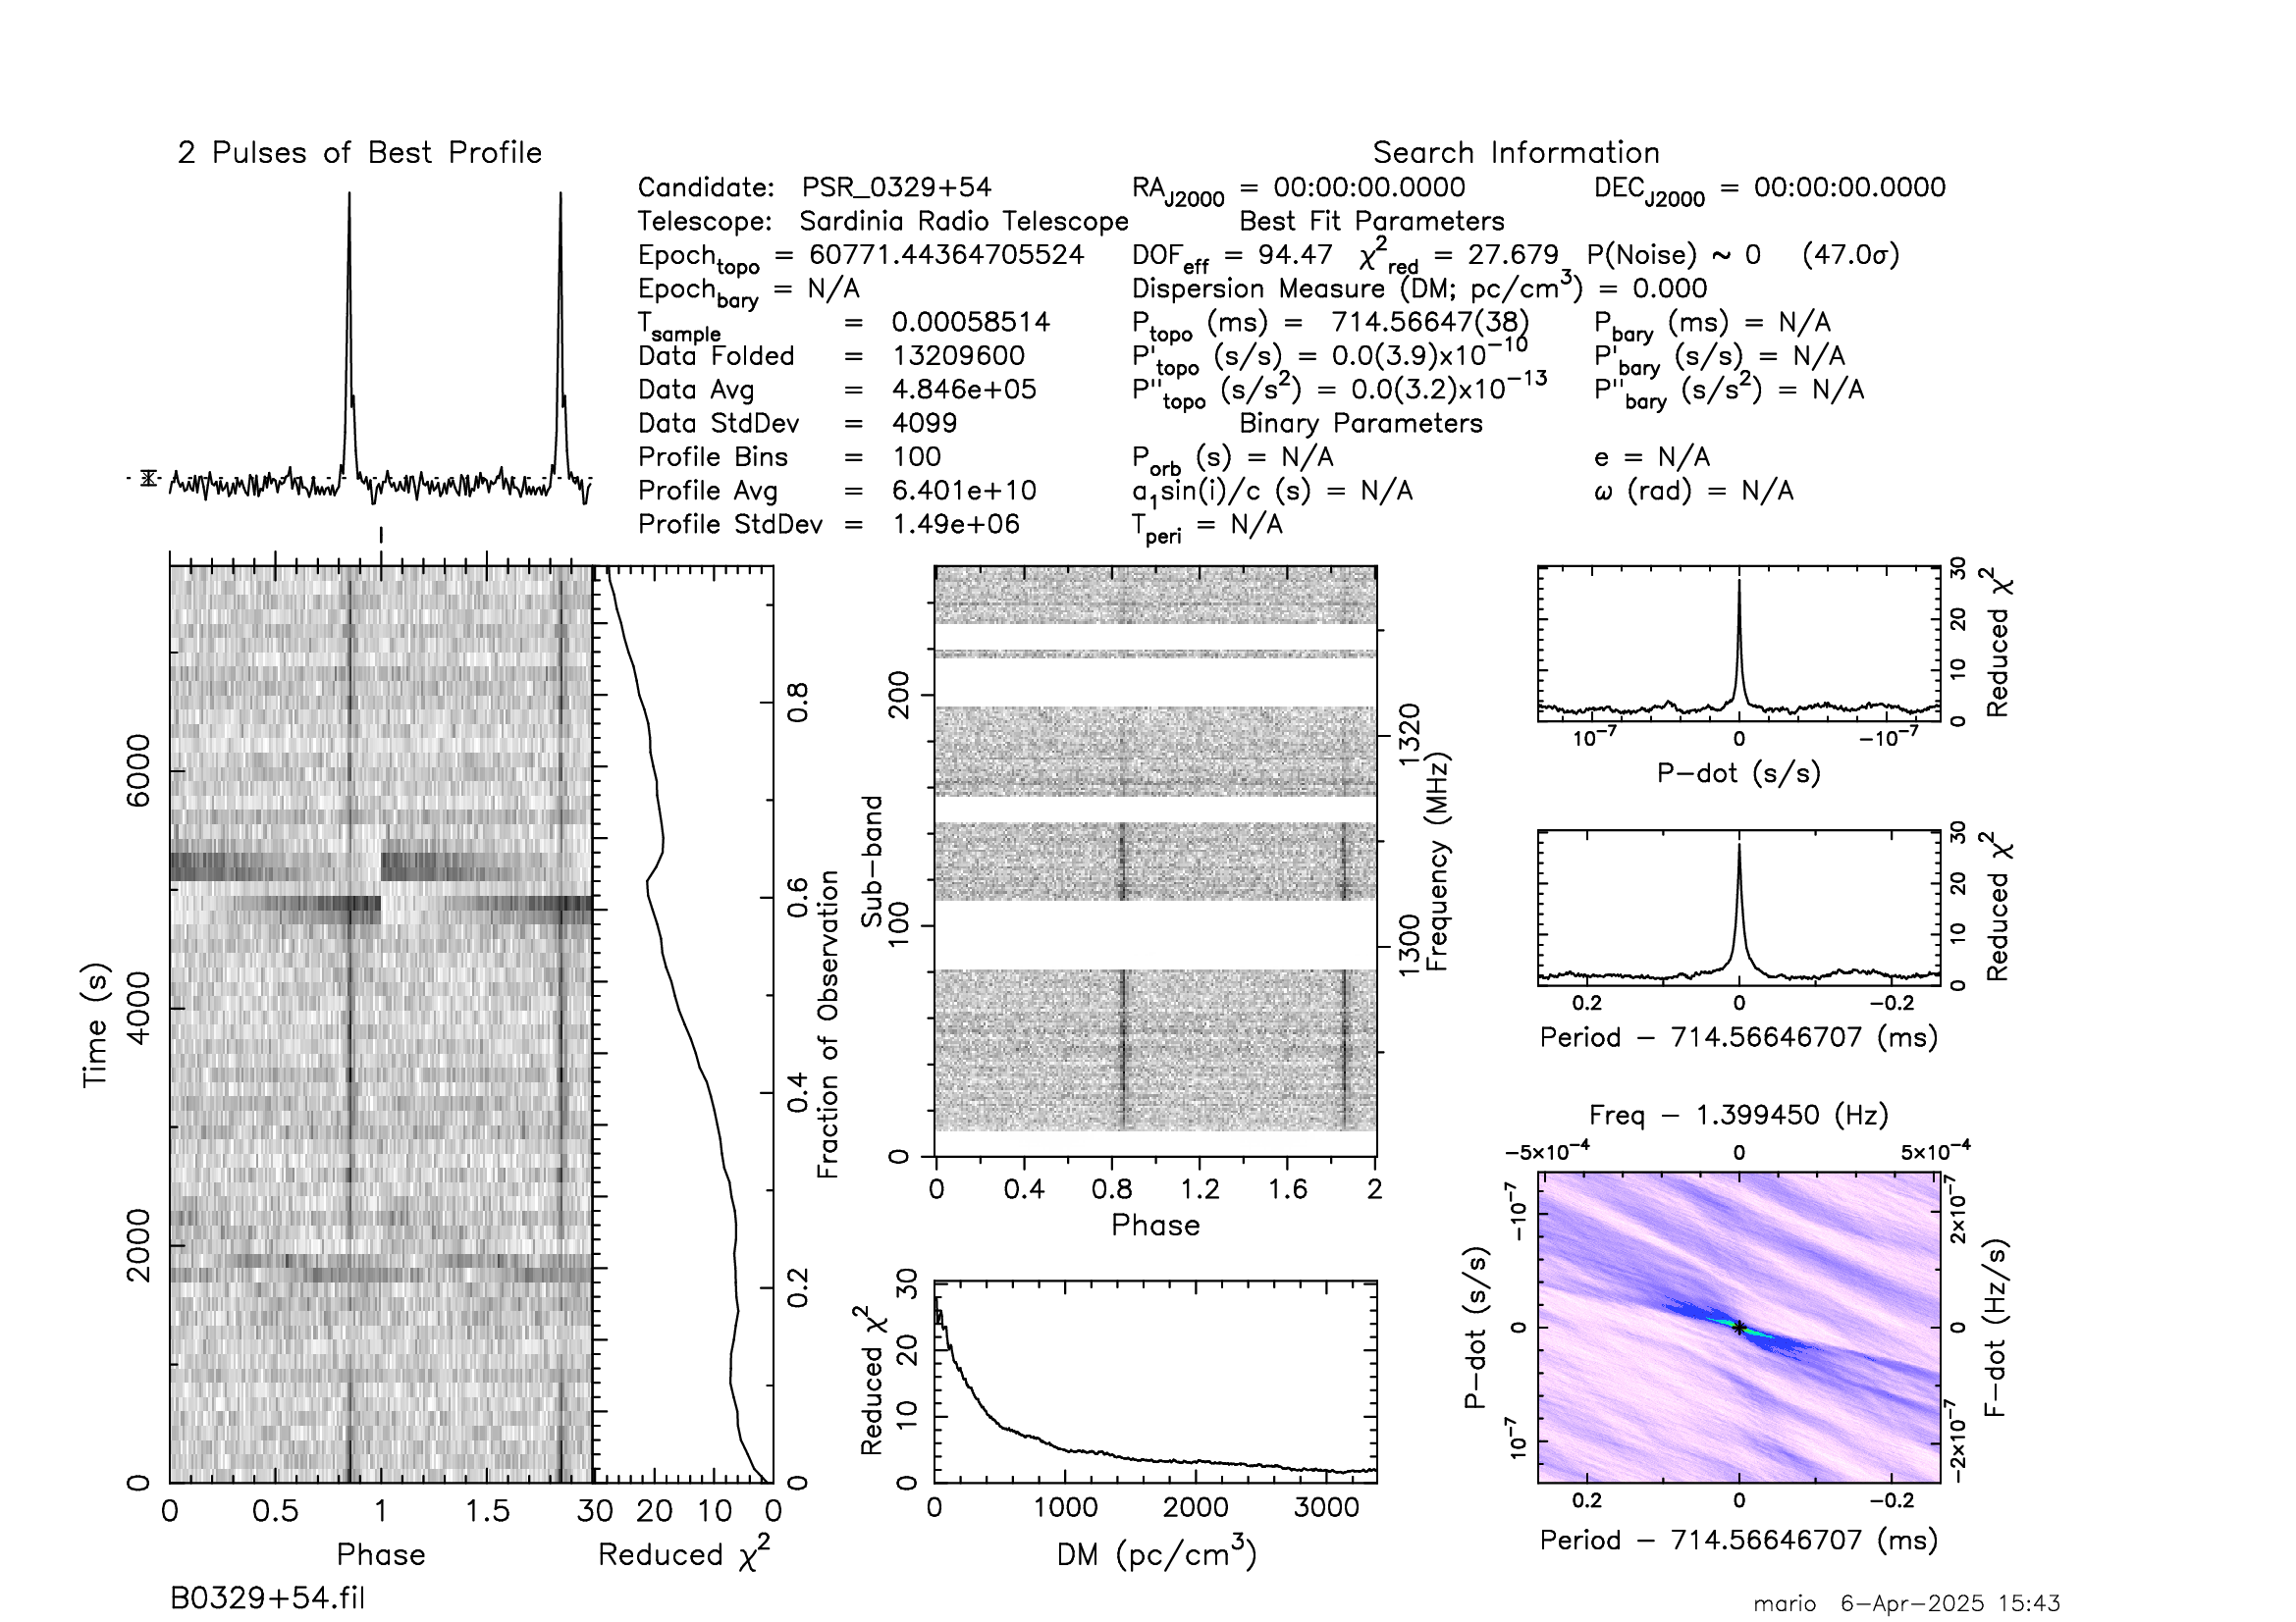
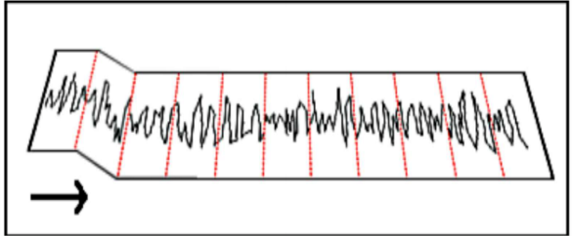
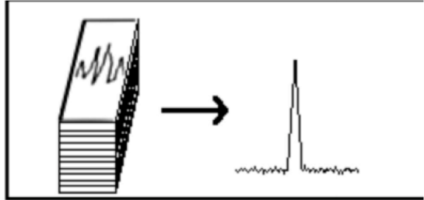

Murmur
Notes on the detection method
Amateur-grade instruments cannot detect pulsars in real time … up to now ! ; instead, wideband data ( integration bandwidth ) are recorded ( integration time ), segmented, and coherently integrated using specialized software (e.g., PRESTO). Statistical averaging suppresses background noise, while temporally coherent pulsar signals are enhanced to improve detectability.
B0329+54 detection @ 1303 Mhz 2 ½ Hours. 56 Mhz BW
Eucara 2025 Conference, Harwell 6th-7th September
Impedimentum pro occasione arripere
Mario Armando Natali

Slide 5
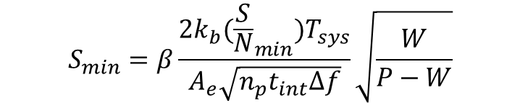
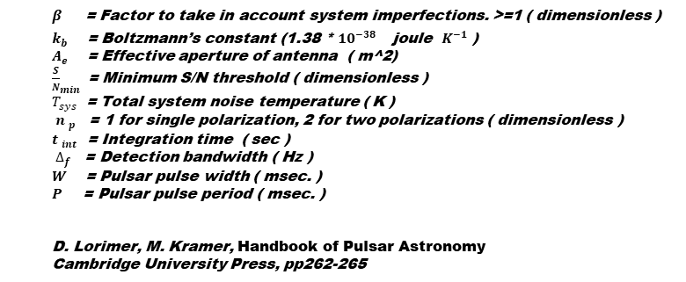
Murmur
Radiometer equation
The estimation of pulsar emission detectability entails a comparative evaluation of the performance parameters of the receiving system against the intrinsic characteristics of the pulsar signal. This evaluation is conducted through the application of the so called modified radiometer equation.
${β }_{}$ = Factor to take in account system imperfections. >=1 ( dimensionless )
$k_{b}$ = Boltzmann’s constant (1.38 * ${{10}^{−38}}^{}$ joule $K^{−1}$ )
$A_{e}$ = Effective aperture of antenna ( m^2)
${\frac{S}{N}}_{min}$= Minimum S/N threshold ( dimensionless )
$T_{sys}$ = Total system noise temperature ( K )
${ n }_{p}$ = 1 for single polarization, 2 for two polarizations ( dimensionless )
${t }_{int}$ = Integration time ( sec )
$∆_{f}$ = Detection bandwidth ( Hz )
$W$= Pulsar pulse width ( msec. )
$P$ = Pulsar pulse period ( msec. )
D. Lorimer, M. Kramer, Handbook of Pulsar Astronomy
Cambridge University Press, pp262-265
$$S_{min}=β\frac{2k_{b}({\frac{S}{N}}_{min})T_{sys}}{A_{e}\sqrt{n_{p}t_{int}∆f}}\sqrt{\frac{W}{P−W}}$$
$S_{min}$ = Minimum Detectable Signal ( Jansky )
To streamline this process, MURMUR automatically solves the modified radiometer equation and computes additional parameters relevant to observation planning, data acquisition, and optimization of receiving systems.
Eucara 2025 Conference, Harwell 6th-7th September
Impedimentum pro occasione arripere
Mario Armando Natali

Slide 6
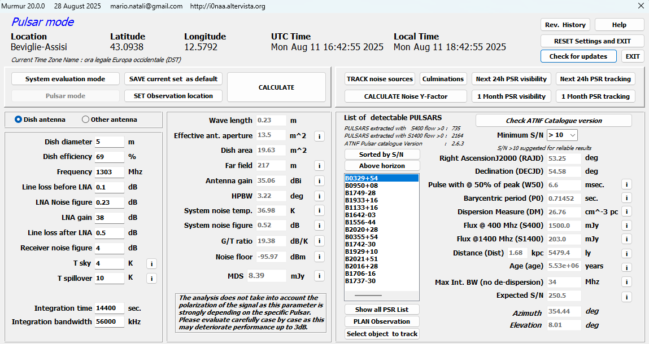
Murmur
Installation
MURMUR, freely available at https://i0naa.altervista.org, is compatible with Windows 10 and 11 and installs by default in C:\Murmur, including the executable and all necessary resources.
MURMUR, developed with Embarcadero® C++Builder 10.2 and the Epina GmbH SDL Component Suite, does not use the Windows registry and can be completely removed by uninstalling and deleting its installation directory.
Checksum information of installation file are also provided (CRC32, CRC64 , SHA256, SHA1, BLAKE2sp, MD5, XXH64, SHA384, SHA 512, SHA512 ).
Eucara 2025 Conference, Harwell 6th-7th September
Impedimentum pro occasione arripere
Mario Armando Natali

Slide 7
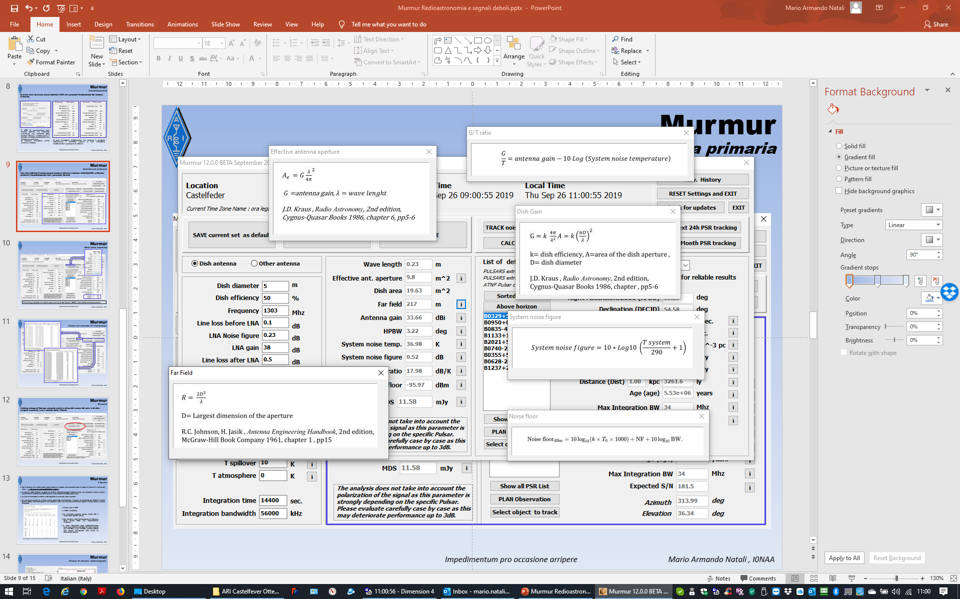
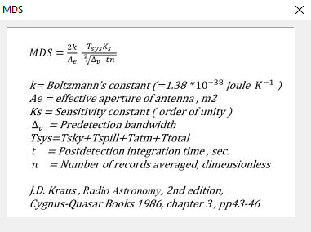
Murmur
The location can be defined either by coordinates or by
Maidenhead Locator
( aka QRA Locator )
Primary interface for radio parameters
The small buttons provide explanations regarding the method used to calculate the parameters.
Eucara 2025 Conference, Harwell 6th-7th September
Impedimentum pro occasione arripere
Mario Armando Natali

Slide 8
Murmur
Primary interface for Pulsar parameters
The Calculate function displays the set of pulsars that are potentially detectable given the specified configuration, integration time, and bandwidth. Selecting the Above Horizon option extends the analysis to include pulsars located below the local horizon.
Eucara 2025 Conference, Harwell 6th-7th September
Impedimentum pro occasione arripere
Mario Armando Natali

Slide 9
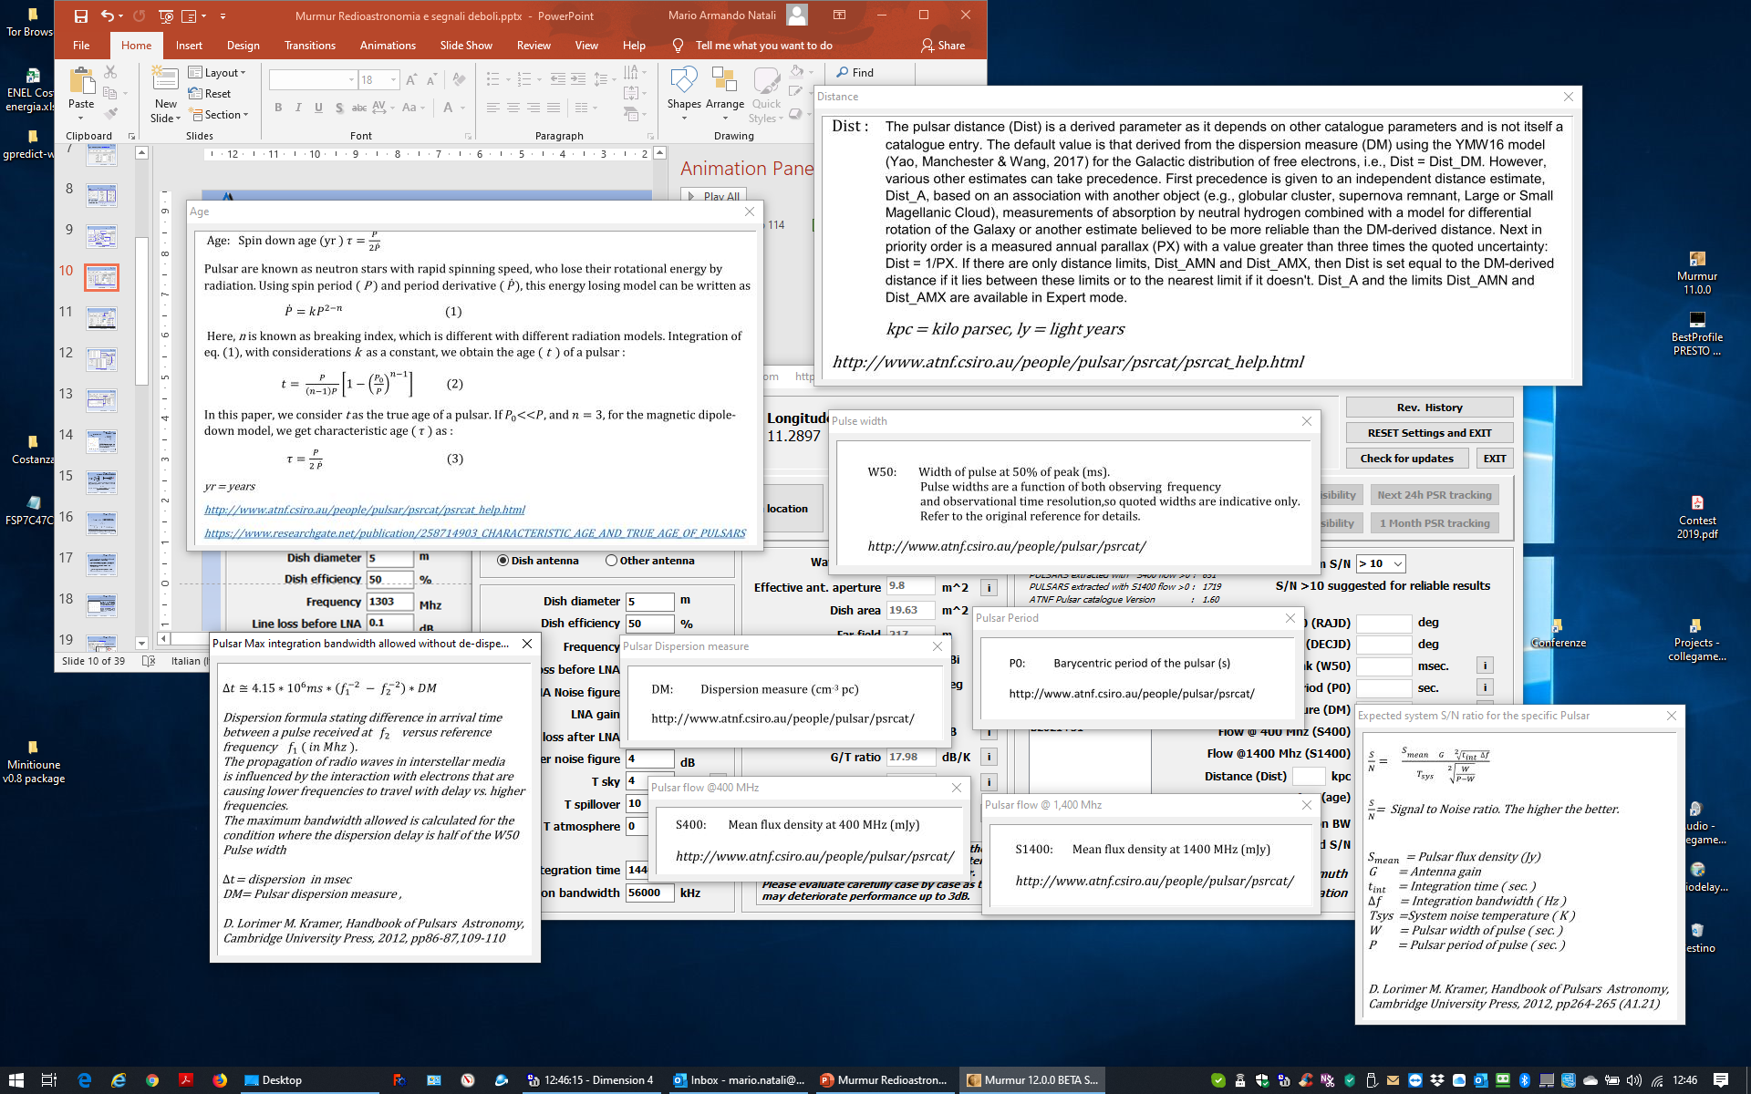

Murmur
The pulsar parameters are obtained from
ATNF PULSAR CATALOGUE :
atnf.csiro.au/research/pulsar/psrcat/
Primary interface for Pulsar parameters
Eucara 2025 Conference, Harwell 6th-7th September
Impedimentum pro occasione arripere
Mario Armando Natali

Slide 10
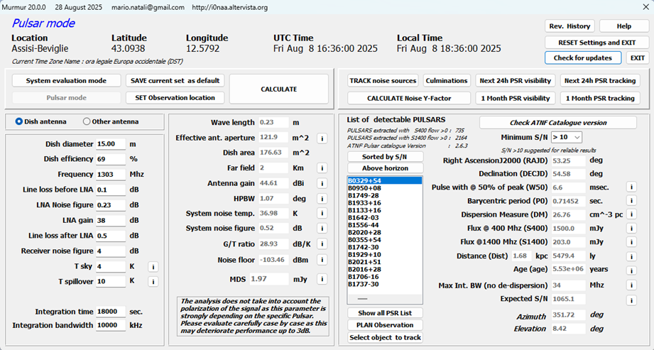

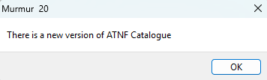

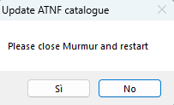
Murmur
Primary interface for Pulsar parameters
From version 20.0.0, Murmur can automatically update its internal pulsar database by downloading the latest ATNF Pulsar Catalogue from the Australian Telescope National Facility. The update is initiated via the Check ATNF Catalogue version button; if the internal database is outdated, the software offers the option to replace it with the updated version.
This function is new and closely tied to the ATNF Catalogue structure; errors may occur.
Please report any malfunctions.
Eucara 2025 Conference, Harwell 6th-7th September
Impedimentum pro occasione arripere
Mario Armando Natali

Slide 11
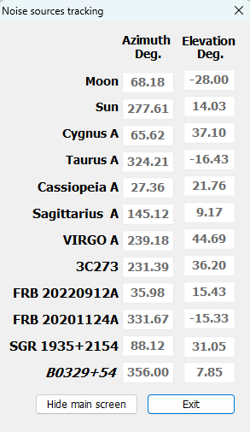
Murmur
Real time tracking
The tracking is based on the open source code WSJT by Joe Taylor ( K1JT ) and is extremely accurate.
Eucara 2025 Conference, Harwell 6th-7th September
Impedimentum pro occasione arripere
Mario Armando Natali

Slide 12
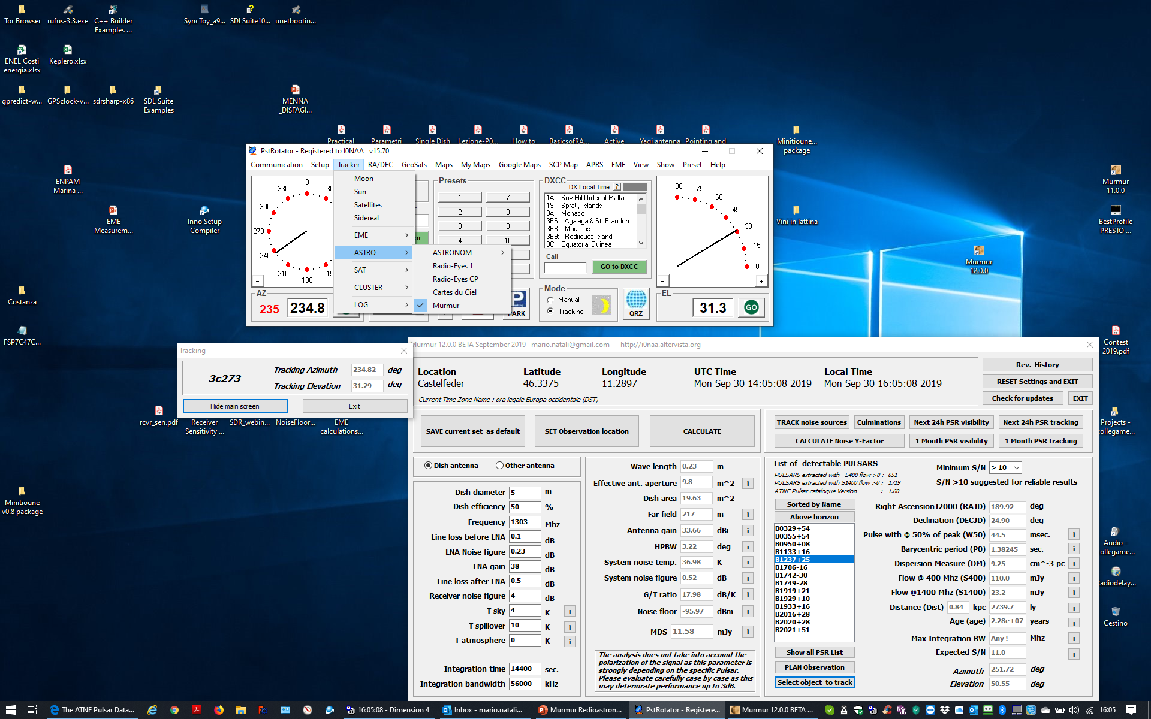
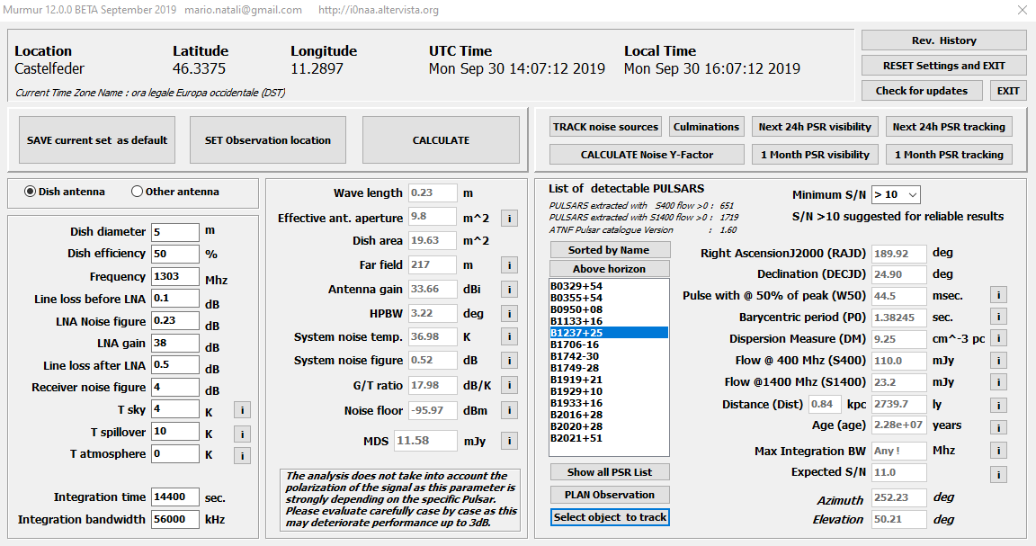
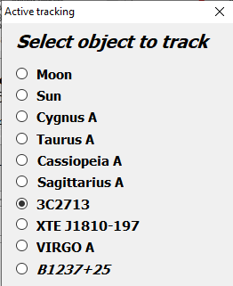
Murmur
Murmur and PstRotator
Through collaboration with Codrut Buta ( YO3DMU ), the developer of PstRotator, the two software packages have been integrated, thereby facilitating the tracking of pulsars and major noise sources .
Eucara 2025 Conference, Harwell 6th-7th September
Impedimentum pro occasione arripere
Mario Armando Natali

Slide 13
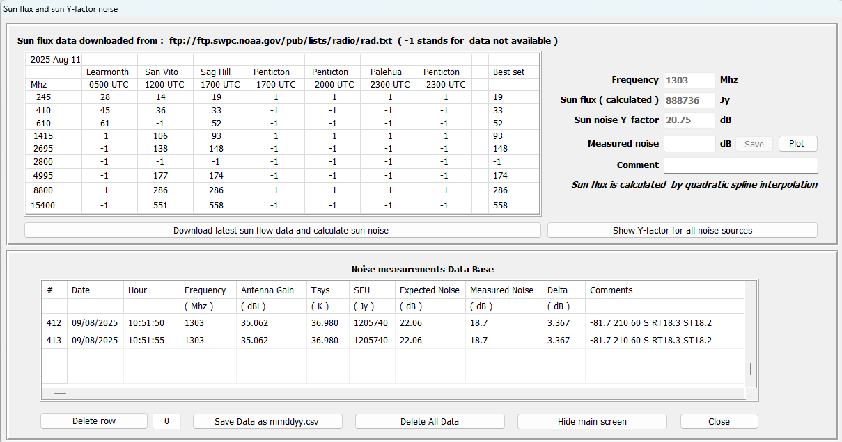
Murmur
Noise prediction
Murmur downloads the most updated sun flux data from NOAA site and, performing a quadratic interpolation, calculates the flux at the frequency of interest and derives the sun noise in dB (Y-factor).
Eucara 2025 Conference, Harwell 6th-7th September
Impedimentum pro occasione arripere
Mario Armando Natali

Slide 14

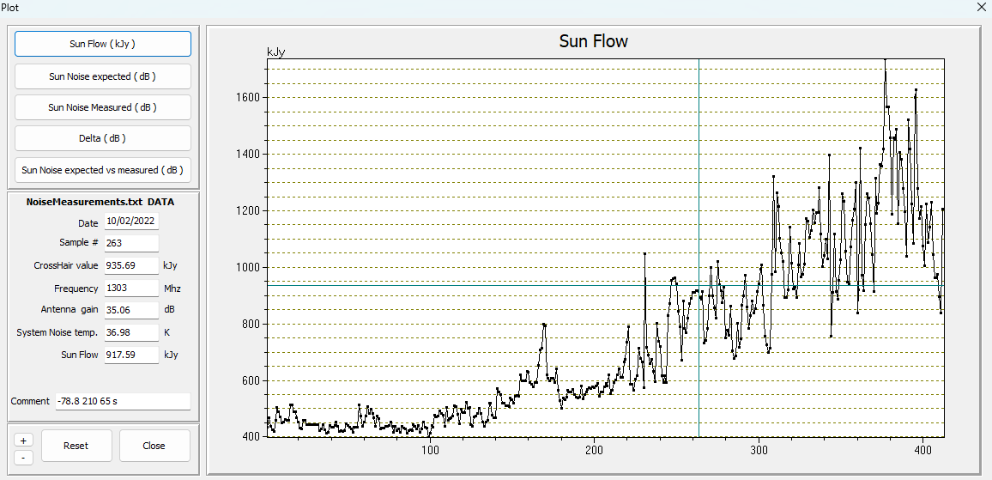
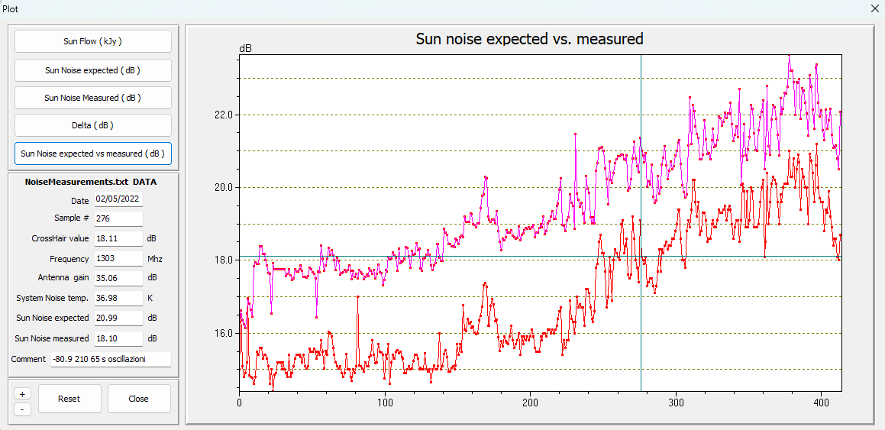
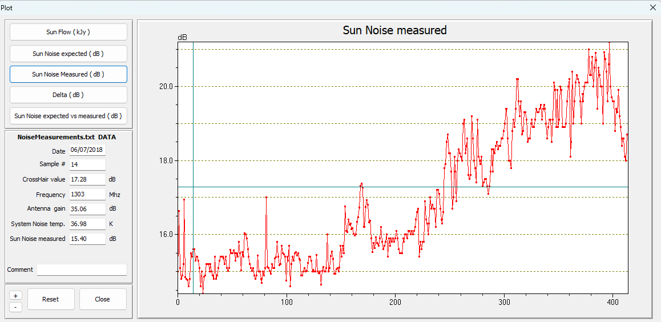
Murmur
Sun Noise data base plotting
By selecting the Plot function, MURMUR generates graphical representations of the data stored in the Sun noise database, offering several visualization options.
Eucara 2025 Conference, Harwell 6th-7th September
Impedimentum pro occasione arripere
Mario Armando Natali

Slide 15
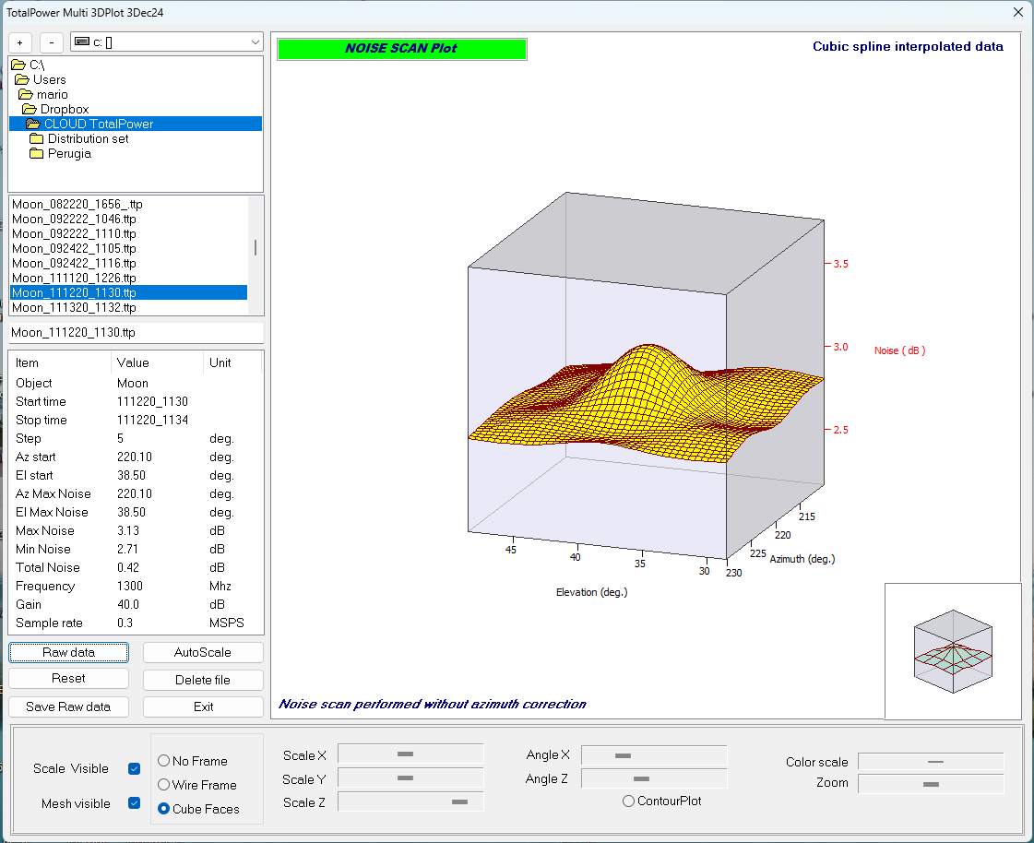
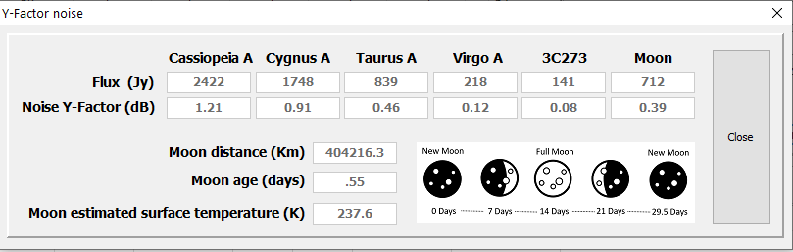


Murmur
Noise prediction from major cosmic sources
By selecting Show Y-Factor for All Noise Sources, MURMUR computes the expected noise level (Y-factor) for the principal noise sources.
Lunar noise is estimated via an algorithm that derives flux from surface temperature, accounting for lunar age (min temp 237.6K max temp 242.4K ) and a three-day lag.
Noise from additional sources is estimated by linearly interpolating published flow data at the frequency of interest.
$$Tant=\left(\frac{Ae}{2760}\right)∗Flow$$
Y$=10∗LOG10\left(\frac{Tant−Tsys}{Tsys}\right)$
Lunar Noise map taken at 1300 Mhz with TotalPower
Reference :
3C273 flux value is calculated by interpolation of data reported in :
M. Türler, S. Paltani, T.J.-L. Courvoisier, et al., « 30 years of multi-wavelenght observations of 3C273 », Astronomy & Astrophysics supplement series, 1999
Cassiopeia A, Cygnus A, Taurus A, Virgo A flux values are calculated by interpolation of data reported in :
J.W.M. Baars, P.G. Mezger, H.Wendker « The flux density values of standard sources used for antenna calibration », NRAO,Green Bank, West Virginia 1964
Moon flux value is calculated with a dedicated algorithm based on :
a) J. Köppen , « Observation of the Moon» , https://portia.astrophysik.uni-kiel.de/~koeppen/10GHz/moon.html
b) D.Morabito, W.Imbriale, S.Keihm « Observing the moon at microwave frequencies using a large-diameter deep space network antenna », IEEE Transactions on
antennas and propagation , 2008
Eucara 2025 Conference, Harwell 6th-7th September
Impedimentum pro occasione arripere
Mario Armando Natali

Slide 16
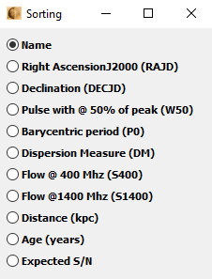
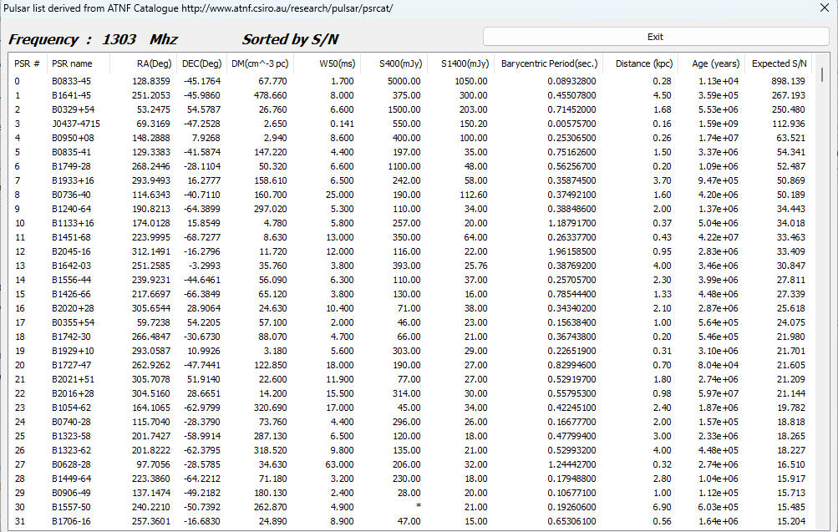
Murmur
Pulsars Data Base
Pulsar fluxes considered, up to the current version, are limited to S₄₀₀ and S₁₄₀₀ ( 400 Mhz and 1400 Mhz ).
Eucara 2025 Conference, Harwell 6th-7th September
Impedimentum pro occasione arripere
Mario Armando Natali

Slide 17
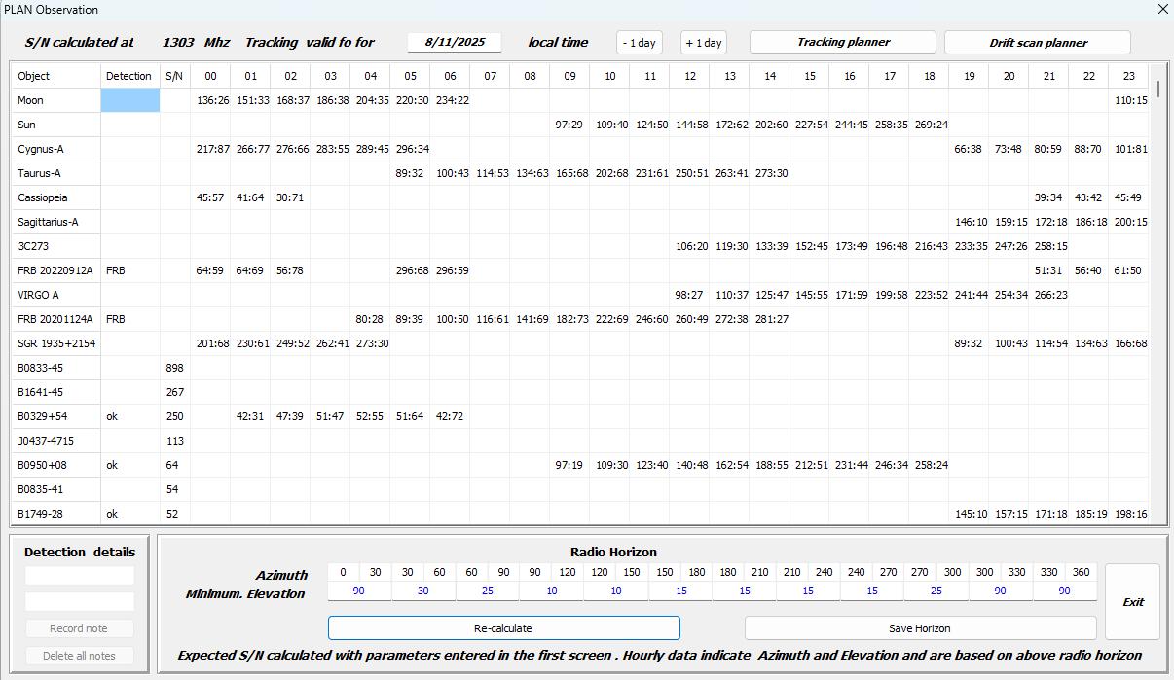
Murmur
PLAN Observations
The Plan Observation interface displays all objects in the current internal database along with their respective azimuth and elevation values for each hour of the day (00 to 23). For all pulsars, the expected signal-to-noise ratio (S/N) is also provided. Within the Radio Horizon sub-interface, it is possible to define the local radio horizon by specifying the minimum elevation in 30° increments.
Eucara 2025 Conference, Harwell 6th-7th September
Impedimentum pro occasione arripere
Mario Armando Natali

Slide 18
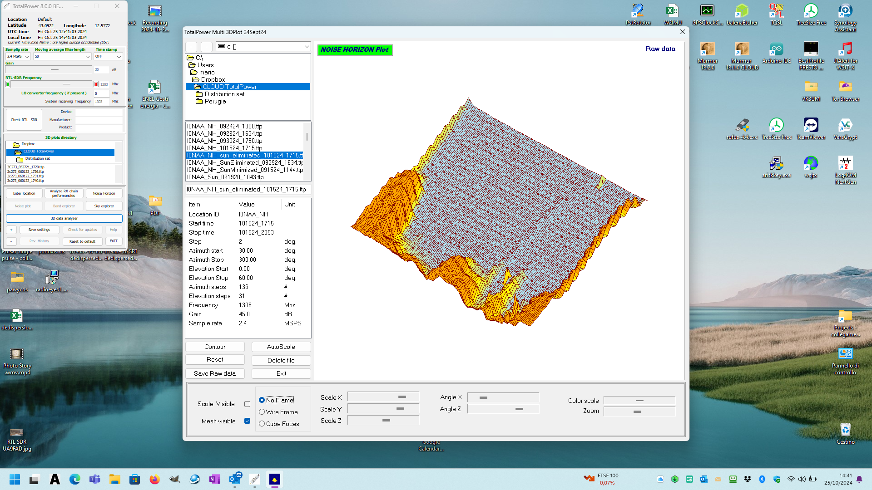
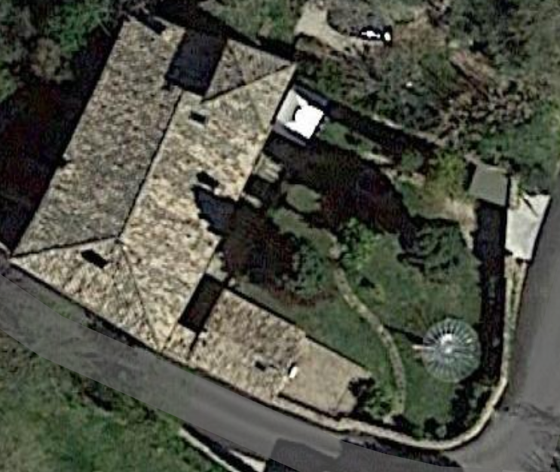
Murmur
PLAN Observations
The Radio Horizon function is particularly useful, as it enables the exclusion of all objects that cannot be detected due to obstructions or local radio interference.
N
S
Noise map taken @ 2 deg. steps at 1308 Mhz with TotalPower
Eucara 2025 Conference, Harwell 6th-7th September
Impedimentum pro occasione arripere
Mario Armando Natali

Slide 19
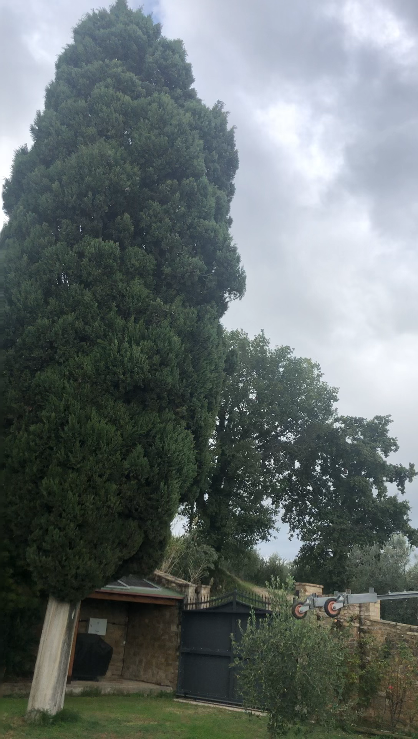
Murmur
..... Feeling Jansky
Noise map taken @ 2 deg. steps at 1308 Mhz with TotalPower
Significant contribution of noise originating from the ground and vegetation.
Eucara 2025 Conference, Harwell 6th-7th September
Impedimentum pro occasione arripere
Mario Armando Natali

Slide 20
Murmur
Future developments
MURMUR demonstrates a high degree of stability, with over 3,000 downloads and global adoption. The software is under continuous development; therefore, users are advised to regularly utilize the Check for Updates function.
Few improvements are already under analysis :
  Add background sky temperature.
  Add Pulsar flux frequency ranges on top of S₄₀₀ and S₁₄₀₀.
  Improve dish-antenna gain prediction accounting for reflector mesh and additional parameters.
  Add general analysis of dish performance based on excellent guides from Professor Joachim Koeppen, ( DF3GJ )
  https://portia.astrophysik.uni-kiel.de/~koeppen/index.html
Suggestions, corrections, annotations, and requests for new features are highly valued and sincerely appreciated !
Eucara 2025 Conference, Harwell 6th-7th September
Impedimentum pro occasione arripere
Mario Armando Natali

Slide 21

Murmur
CAVEAT ...
Do I get this right ? You tell your partner:
«Sorry dear, not tonight. I have a head-
ache» and then you can sit all night and
work with Murmur
Eucara 2025 Conference, Harwell 6th-7th September
Impedimentum pro occasione arripere
Mario Armando Natali

Slide 22
Grazie !
Thanks !
Eucara 2025 Conference, Harwell 6th-7th September
Impedimentum pro occasione arripere
Mario Armando Natali

