Slide 1
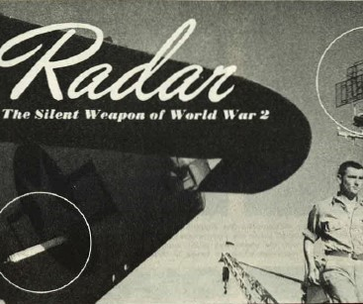
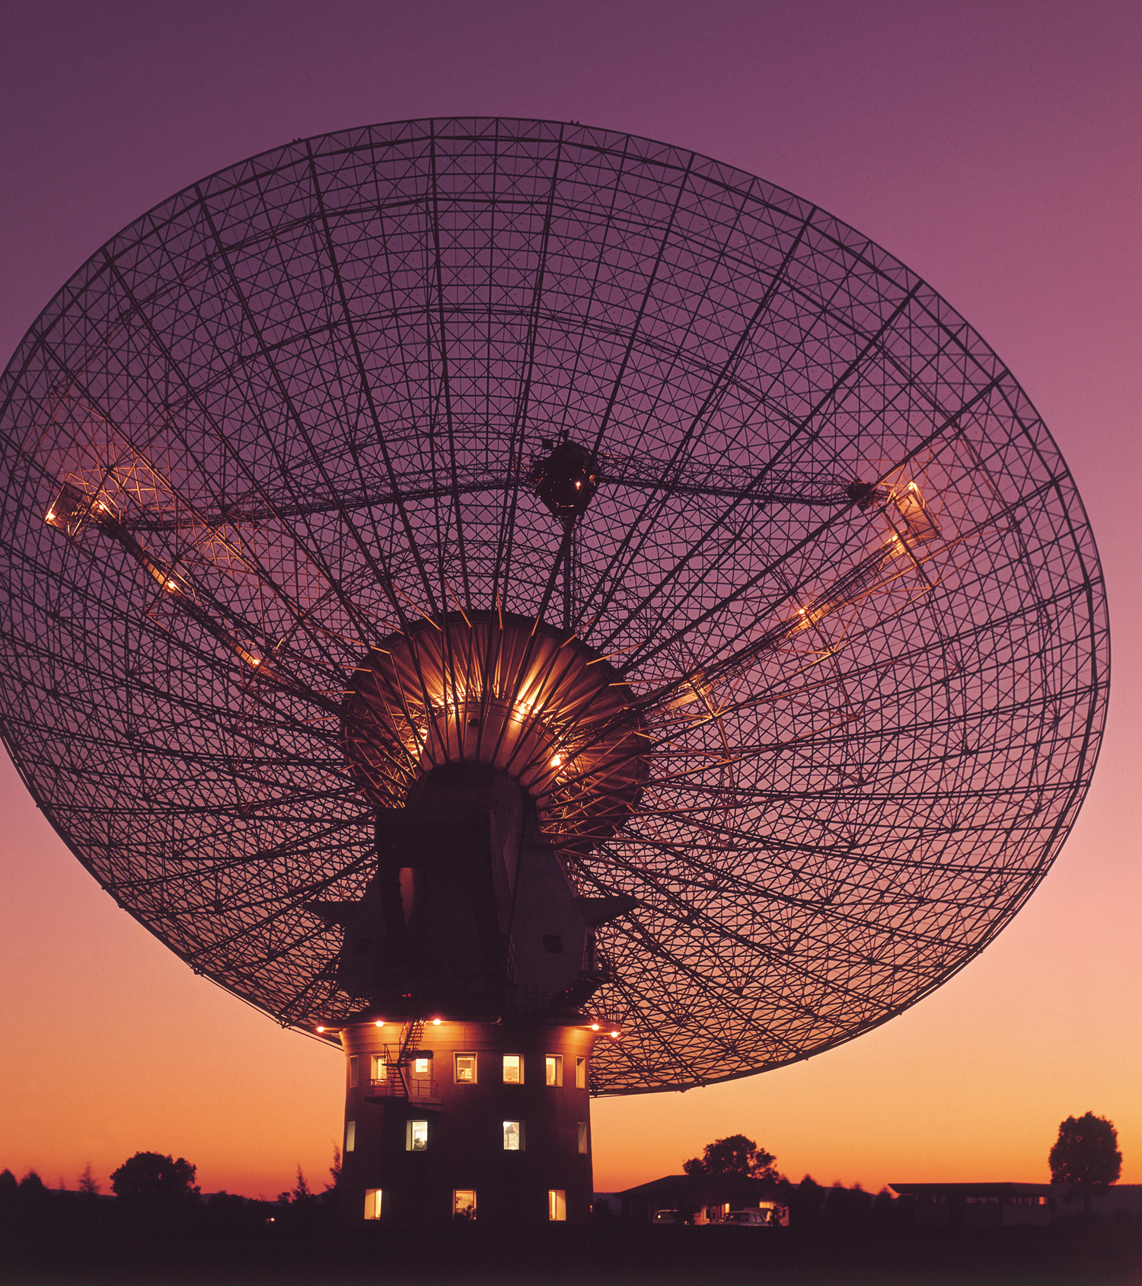
Radar and the Birth of Radio Astronomy
Notes:
The Parkes Radio Telescope (right) opened in 1961 and as well as having a long history tracking quasars and pulsars, transmitted the live TV pictures of the Apollo 11 mission in July 1969.

Slide 2
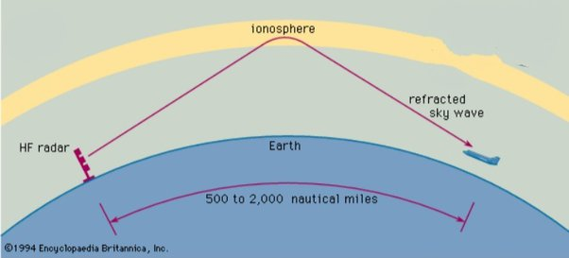
Mystery of Radio Waves…do they creep or bounce?
1901: first successful Transatlantic radio transmission of 2,000 miles Cornwall to Canada by Marconi
Key Questions: Do radio waves follow the curvature of the earth? Do they creep along the sea or bounce between the earth & the sky ?
1924: discovery by Eddie Appleton of a layer in the Earth’s upper atmosphere that bounces radio waves earthward—the Ionosphere (Nobel Prize 1947).
The discovery of the Ionosphere and the knowledge gained from this discovery paved the way for Radar and then Radio Astronomy.
Notes:
Many of the early Radio Astronomers in Australia and the UK had a background in Ionospheric physics.

Slide 3
Global Radar Development in the 1930s
The name RADAR came from the acronym RAdio Detection And Ranging
Radar was the outcome of top secret research during the mid/late-1930s by scientists and engineers in eight countries:
United States, Great Britain & USSR - ALLIES
Germany, Italy & Japan - AXIS
Holland & France – OCCUPIED DURING WW2
Great Britain shared its radar “secrets” with four Commonwealth nations: Australia, Canada, New Zealand and South Africa.
Notes:
Why was it that Australia & the UK essentially invented Radio Astronomy after WWII when Radar technology was so common? After WWII the US & USSR were pre-occupied with developing a hydrogen bomb; Germany, Italy & Japan had devastated economies and Astronomy was not a priority; Holland & France also had re-building to do after WWII, though interestingly of the European countries they were quickest to embrace Radio Astronomy in the 1950s.

Slide 4
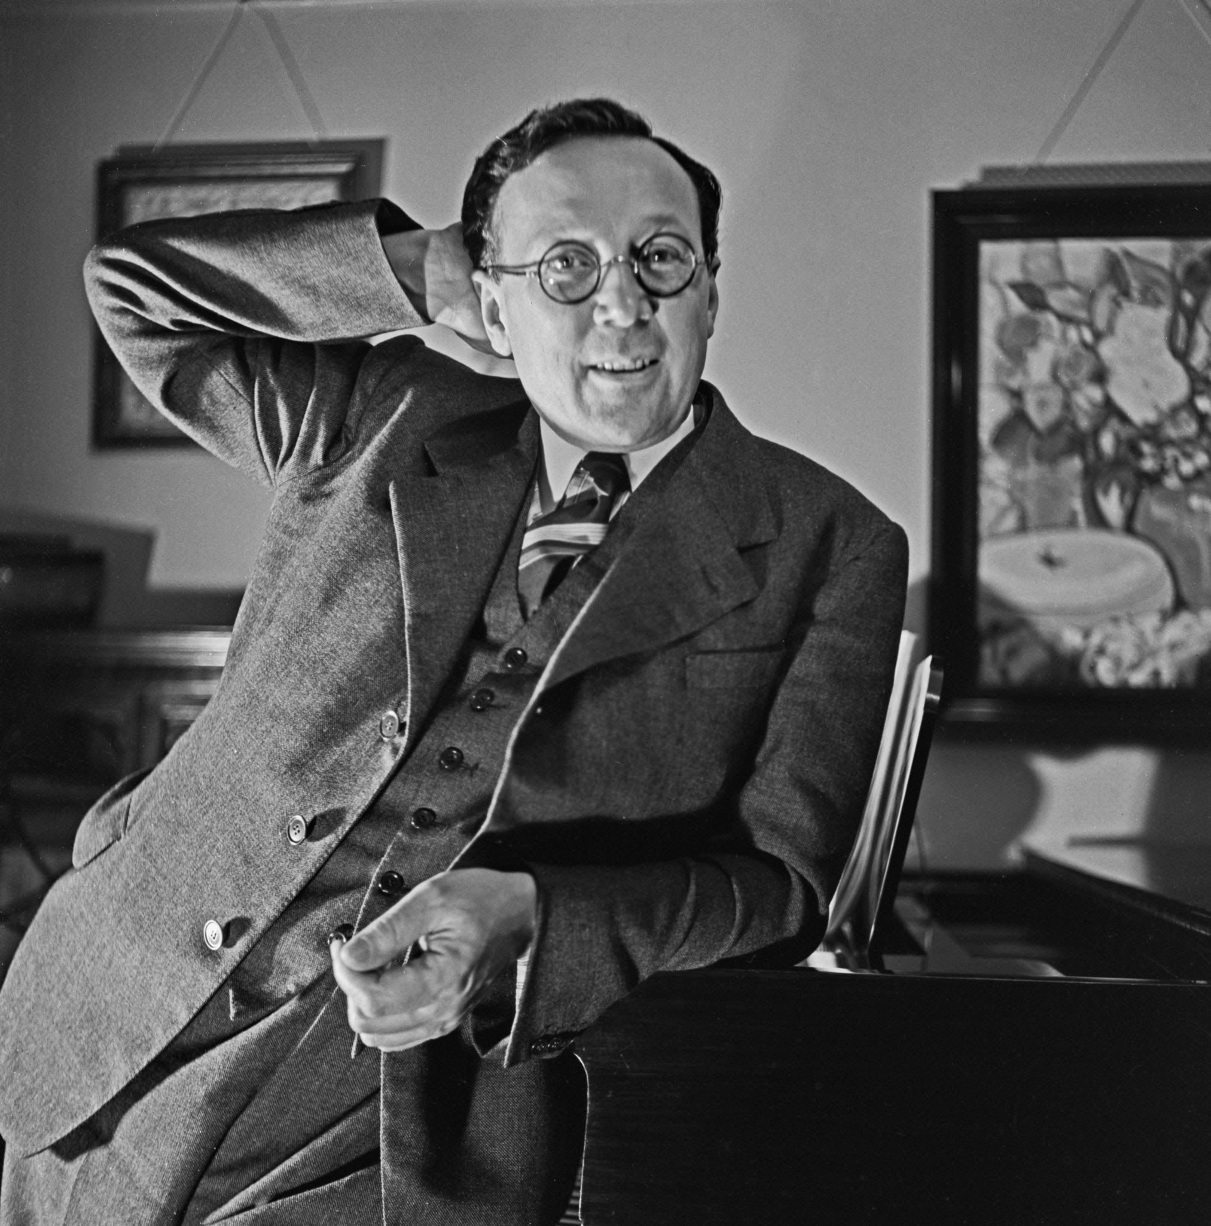
Radar Development in the UK
1927: Radio Research Station Slough – led by Robert Watson-Watt
1934: Article in NY Times concerning a “death ray” invented by Nikola Tesla who said his beam would “drop an army in its tracks and bring down squadrons of airplanes 250 miles away” – science fiction?!
1935: Tizard Committee formed: Watson-Watt had “fanciful” idea of using radio waves to locate aircraft; began first experiments in Suffolk (group of 6)
Late 1930s: A series of Chain Home Low Radar Stations was set up on the English Coast
Notes:
Watson-Watt couldn’t develop a death ray but he had another idea to bounce radio waves off objects to locate their position that gained traction with the Tizard Committee. Within 4 years it led to the development of a ring of Chain Home Low Radar stations around the coast that saved England from invasion during the Battle of Britain in 1940.

Slide 5
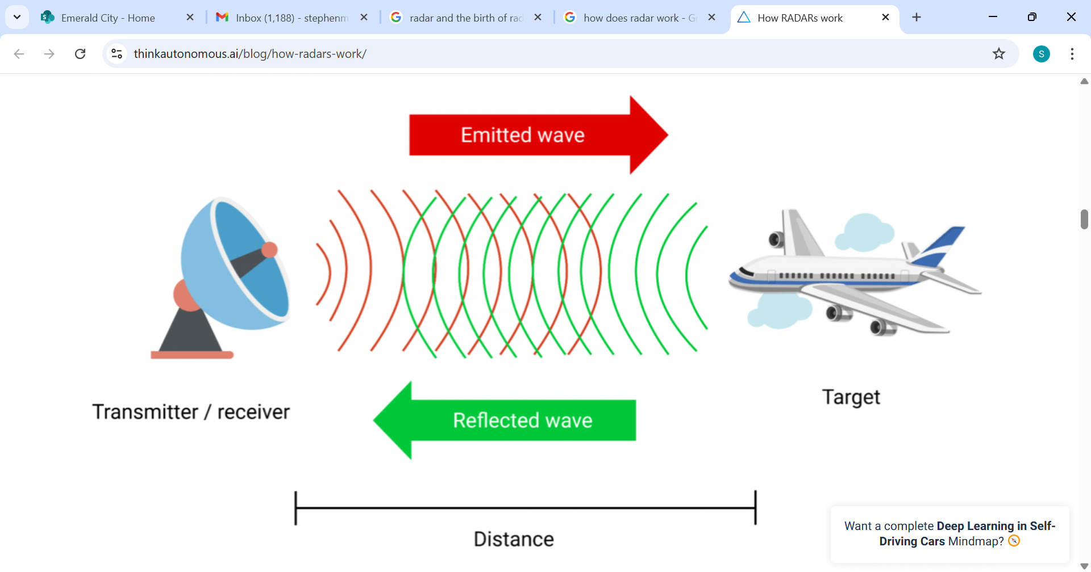
How Does Radar Work?
Radars send out pulses of radio waves, then listen for the signals that are reflected from objects to determine their distance
Radar provided the technology for:
1) sensitive receivers,
2) powerful transmitters; and
3) improved antennas
With a few simple modifications a Radar can be transformed into a Dish that can receive radio waves from Space (ie a Radiotelecope)

Slide 6
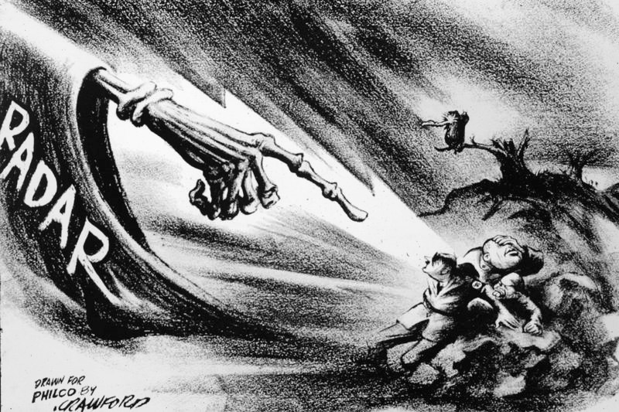
Radar – “wonder weapon” of WW2
Notes:
Radar’s role in WWII cannot be under-estimated – on the sea, in the air and on land. It was both a defensive weapon (to spot incoming enemy aircraft) and an offensive weapon (to more accurately pinpoint enemy targets). Its use by the Allies and Germans can be compared to a huge chess game – one side would innovate and the other side had to quickly counter or be left behind. It has been said that while the Atomic bomb ended the War, Radar actually won it.

Slide 7
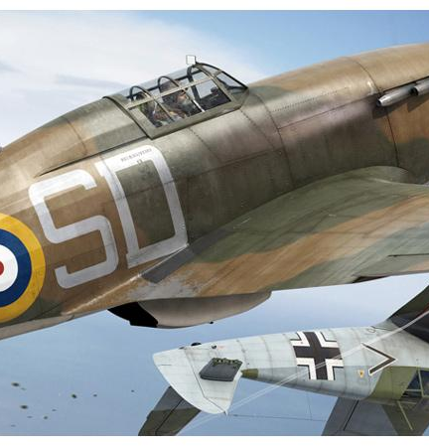
Battle of Britain, 1940
Radar was embraced as a defensive tool in the UK, while Hitler focussed on offensive weapons.
Crucially the Radar stations were able to give the RAF pilots up to 30 minutes notice of incoming German planes.
The RAF were able to match the much larger Luftwaffe and save Britain from invasion.
The Germans made the strategic mistake to bomb cities and left most of the Radar stations intact.

Slide 8
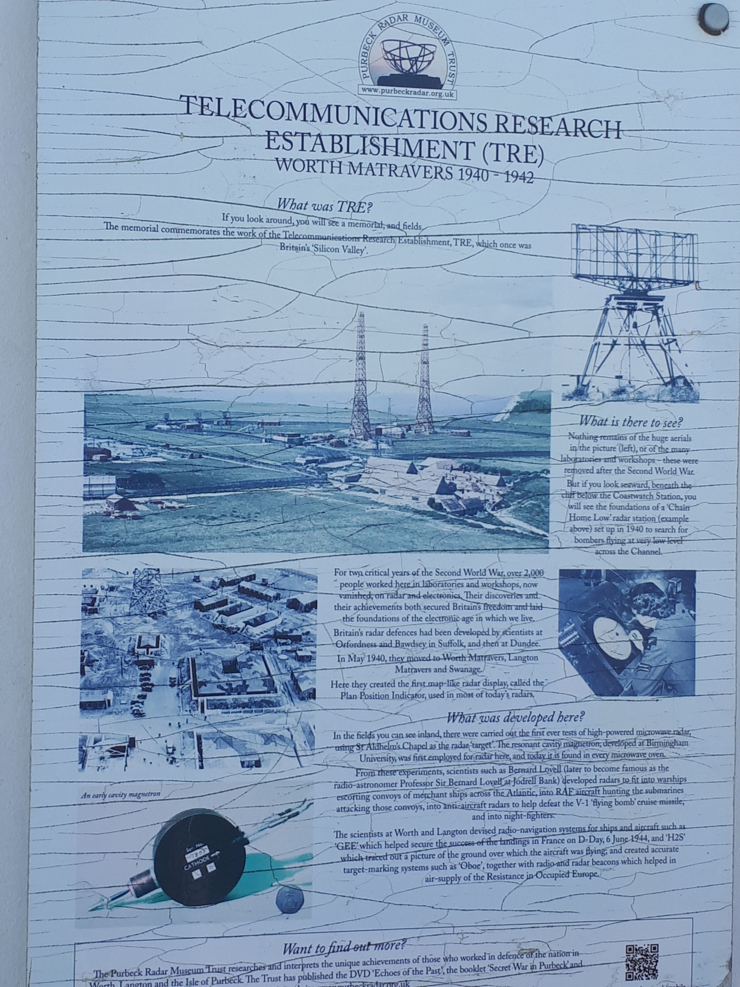
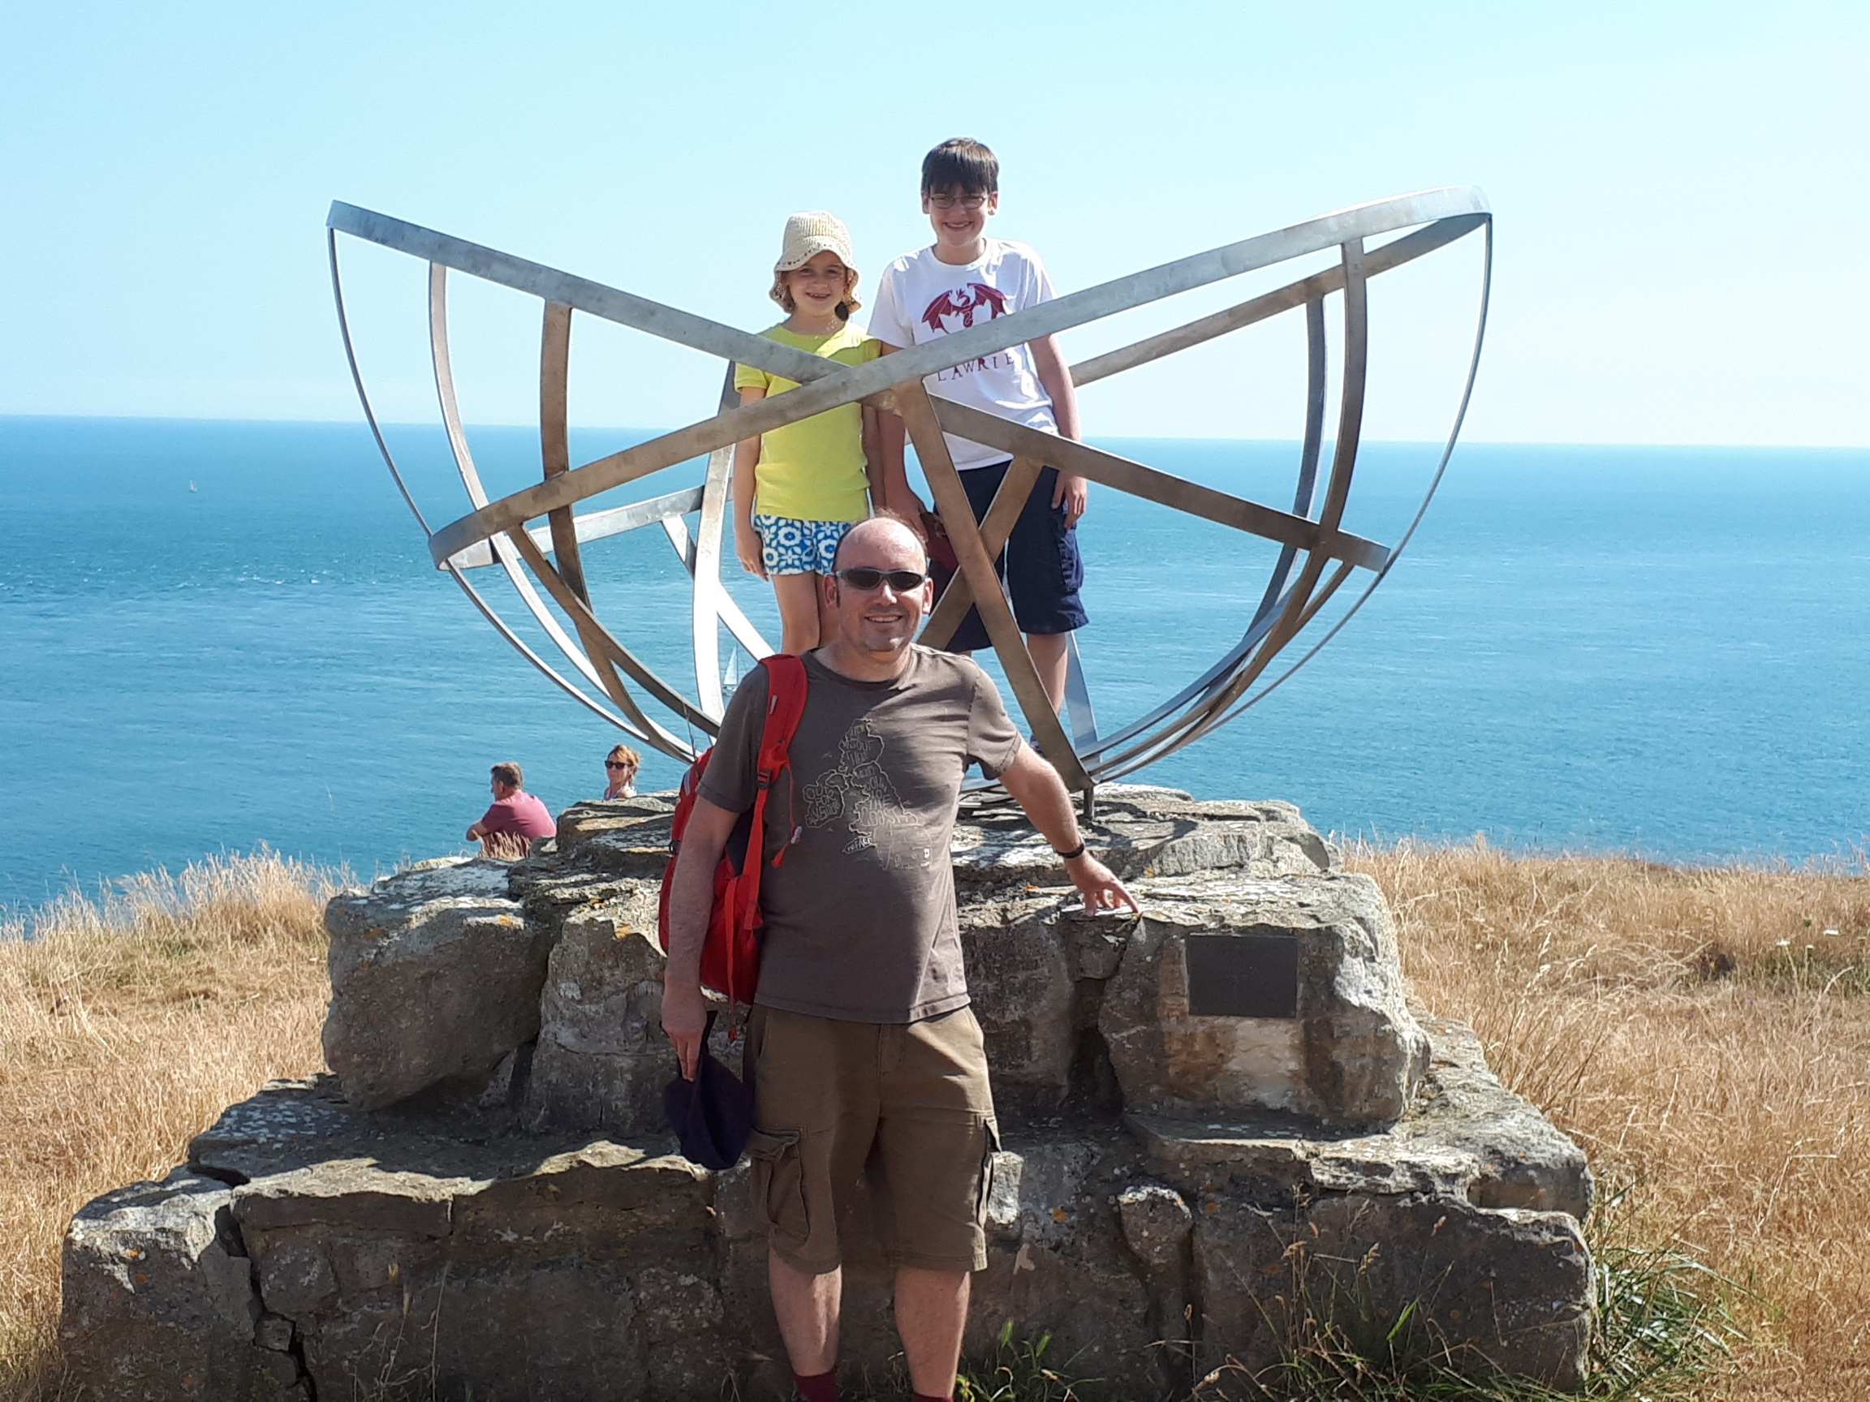
TRE, Worth Matravers (1940-42): Britain’s “Silicon Valley”
Notes:
Telecommunications Research Establishment (TRE) was a deliberately confusing name to put the Germans off its huge strategic importance. Between 1940-42 over 2,000 scientists and support staff were based in Worth Matravers and nearby Swanage. The plaque on the left called it “Britain’s Silicon Valley”.
The memorial on the right was opened by Sir Bernard Lovell at St Aldhelm’s Head in 2006.

Slide 9
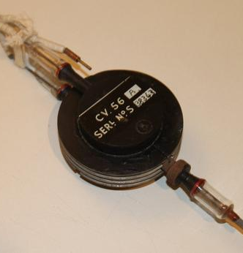
Tizard Mission 1940: The Cavity Magnetron
Cavity Magnetron: a vacuum tube producing microwaves developed at the Uni of Birmingham.
Increased by 1,000 times the power available on centimetric wavelengths and allowed radar to be installed in planes and ships.
Eddie Bowen headed the Mission; it is often called
“the most valuable cargo ever brought to US shores”.
MIT Radiation Laboratory: set up Oct 1940, 4,000 staff at its peak (larger than the Manhattan Project).
Notes:
The cavity magnetron was one of the most important inventions of WWII and gave the Allies a distinct advantage over the Axis powers, allowing them to put miniaturised radars into planes. A version of the cavity magnetron is in every domestic microwave oven.

Slide 10
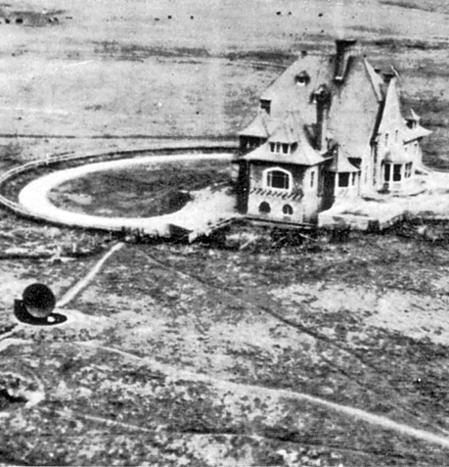
Bruneval Raid, Feb 1942
Aerial reconnaissance uncovered a small rotating tower on a remote clifftop at Bruneval, near Le Havre on the French coast.
Daring night raid managed to recover an intact German Würzburg radar, provided key intelligence on German radar capabilities.
First successful use of British Paratroopers over enemy territory; of 120 paras only 3 killed and 6 taken prisoner.
Raid led by Major John Frost - later led British Airborne troops at Arnhem during Operation Market Garden. Lord Mountbatten & Churchill also involved.
Notes:
This is one of the most famous reconnaissance photos of WWII. The original photo would have been taken from much higher. The photo on the right was taken by a modified Spitfire flying no more than 100-200 metres above the ground – hugely dangerous. Taylor Downing has written a highly recommended account of the raid and its background – Night Raid (2013). 120 men took part in the Raid with only 3 deaths and 6 men taken prisoner: the rest were all rescued safely, making the raid a huge success, with Churchill leading the plaudits. Major John Frost, who led the Bruneval Raid, was portrayed by Anthony Hopkins in the 1977 Richard Attenborough film “A Bridge Too Far”.
During WWII Hughenden Manor in Buckinghamshire (near High Wycombe) was used as a top-secret base for bomb-target mapping, codenamed ‘Operation Hillside’.

Slide 11
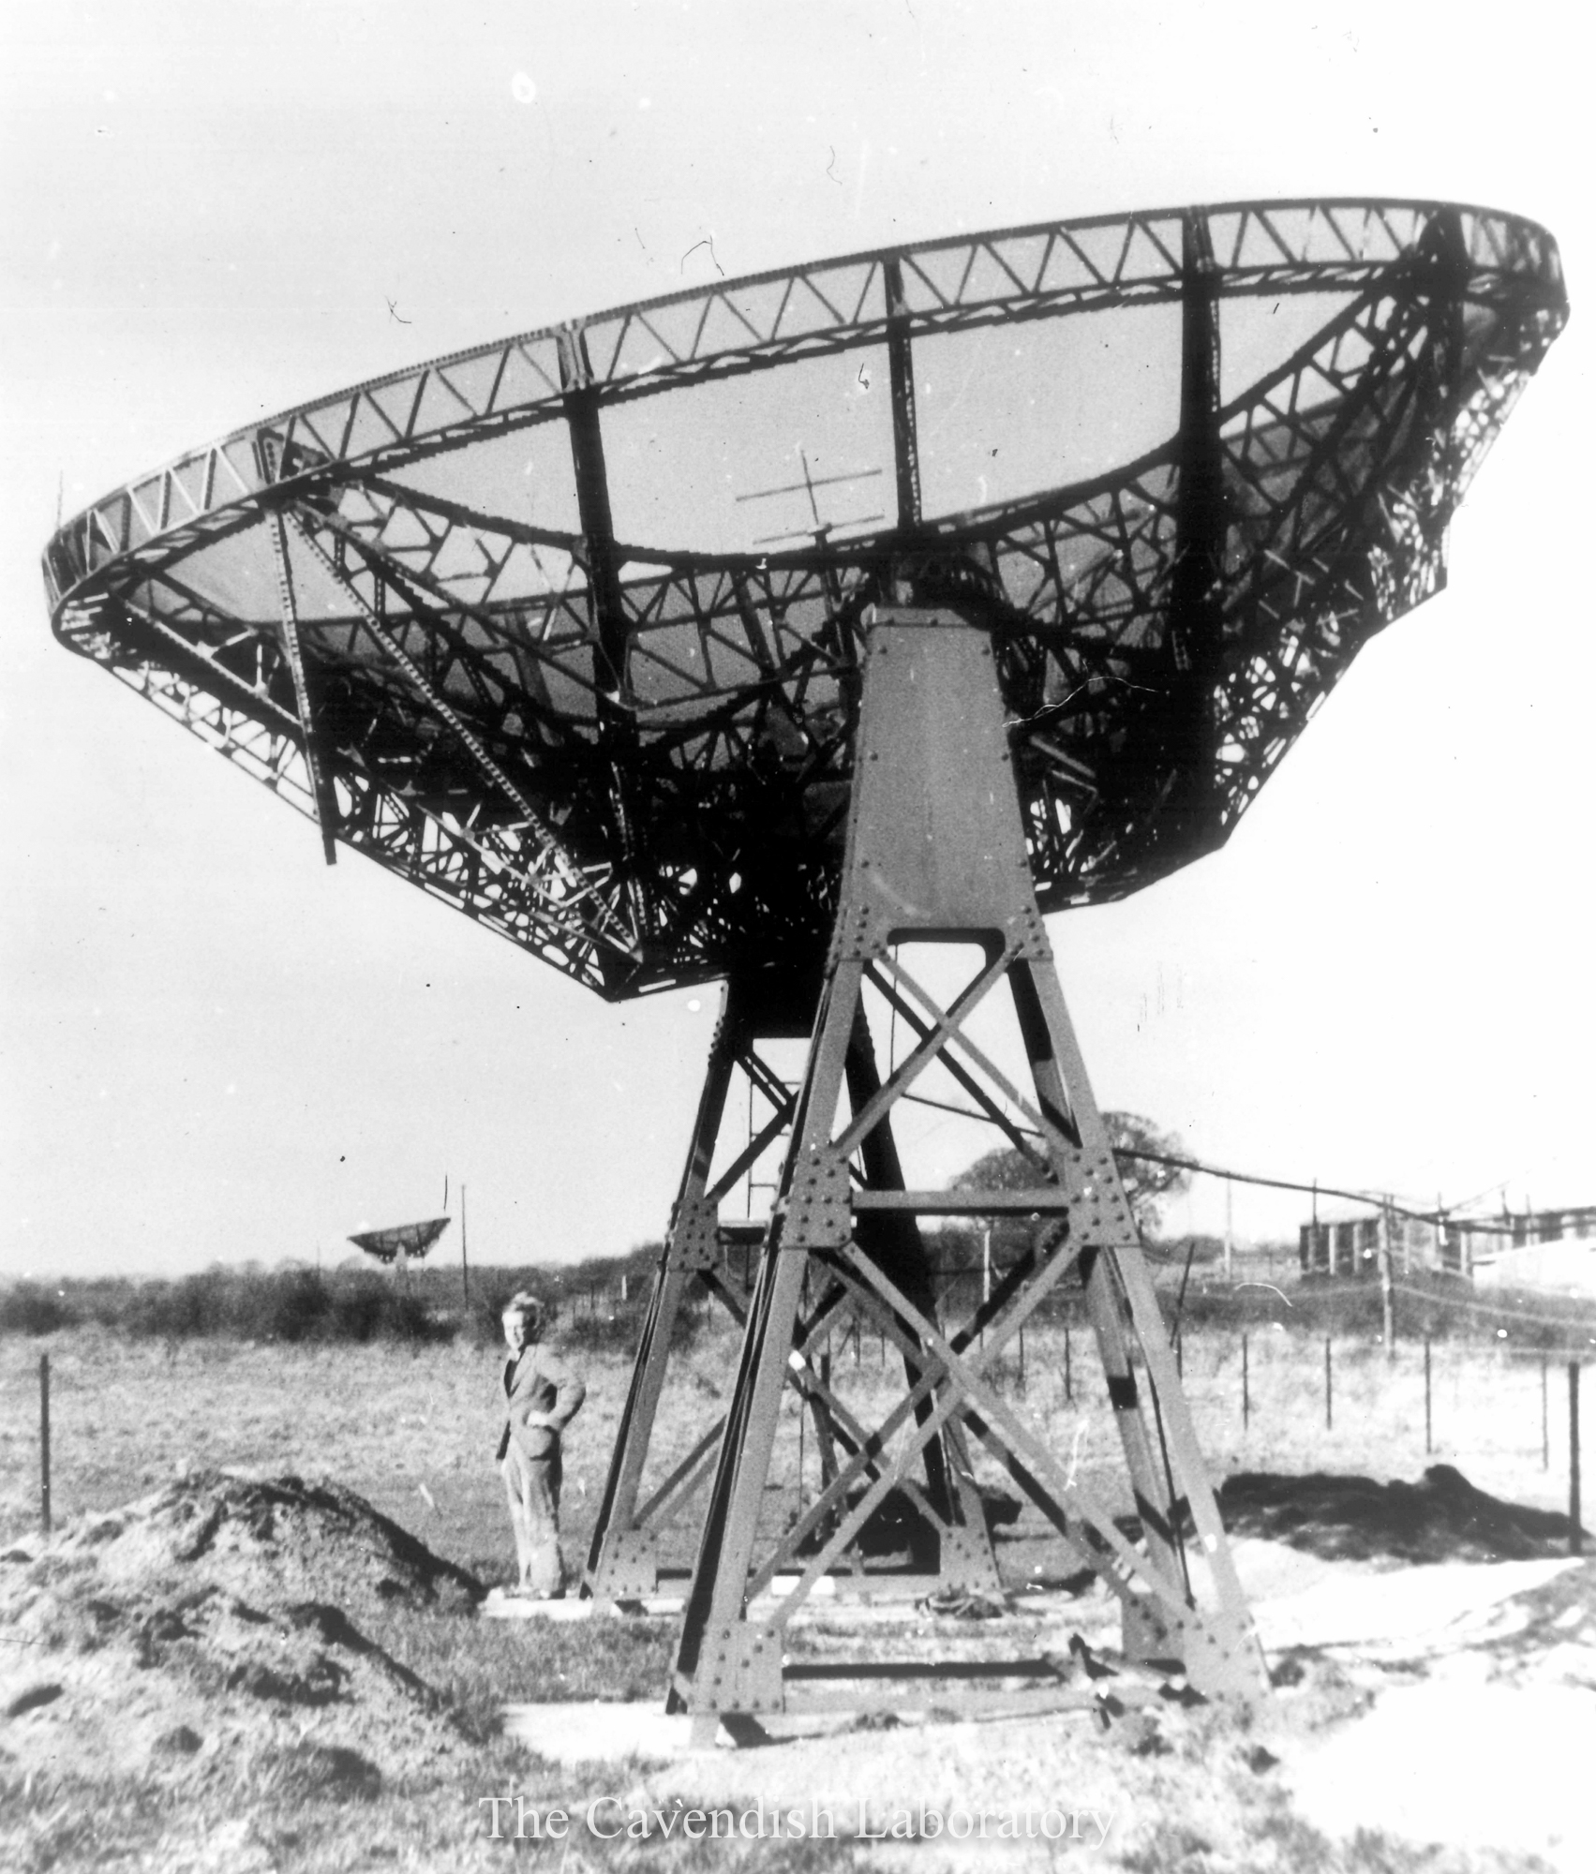
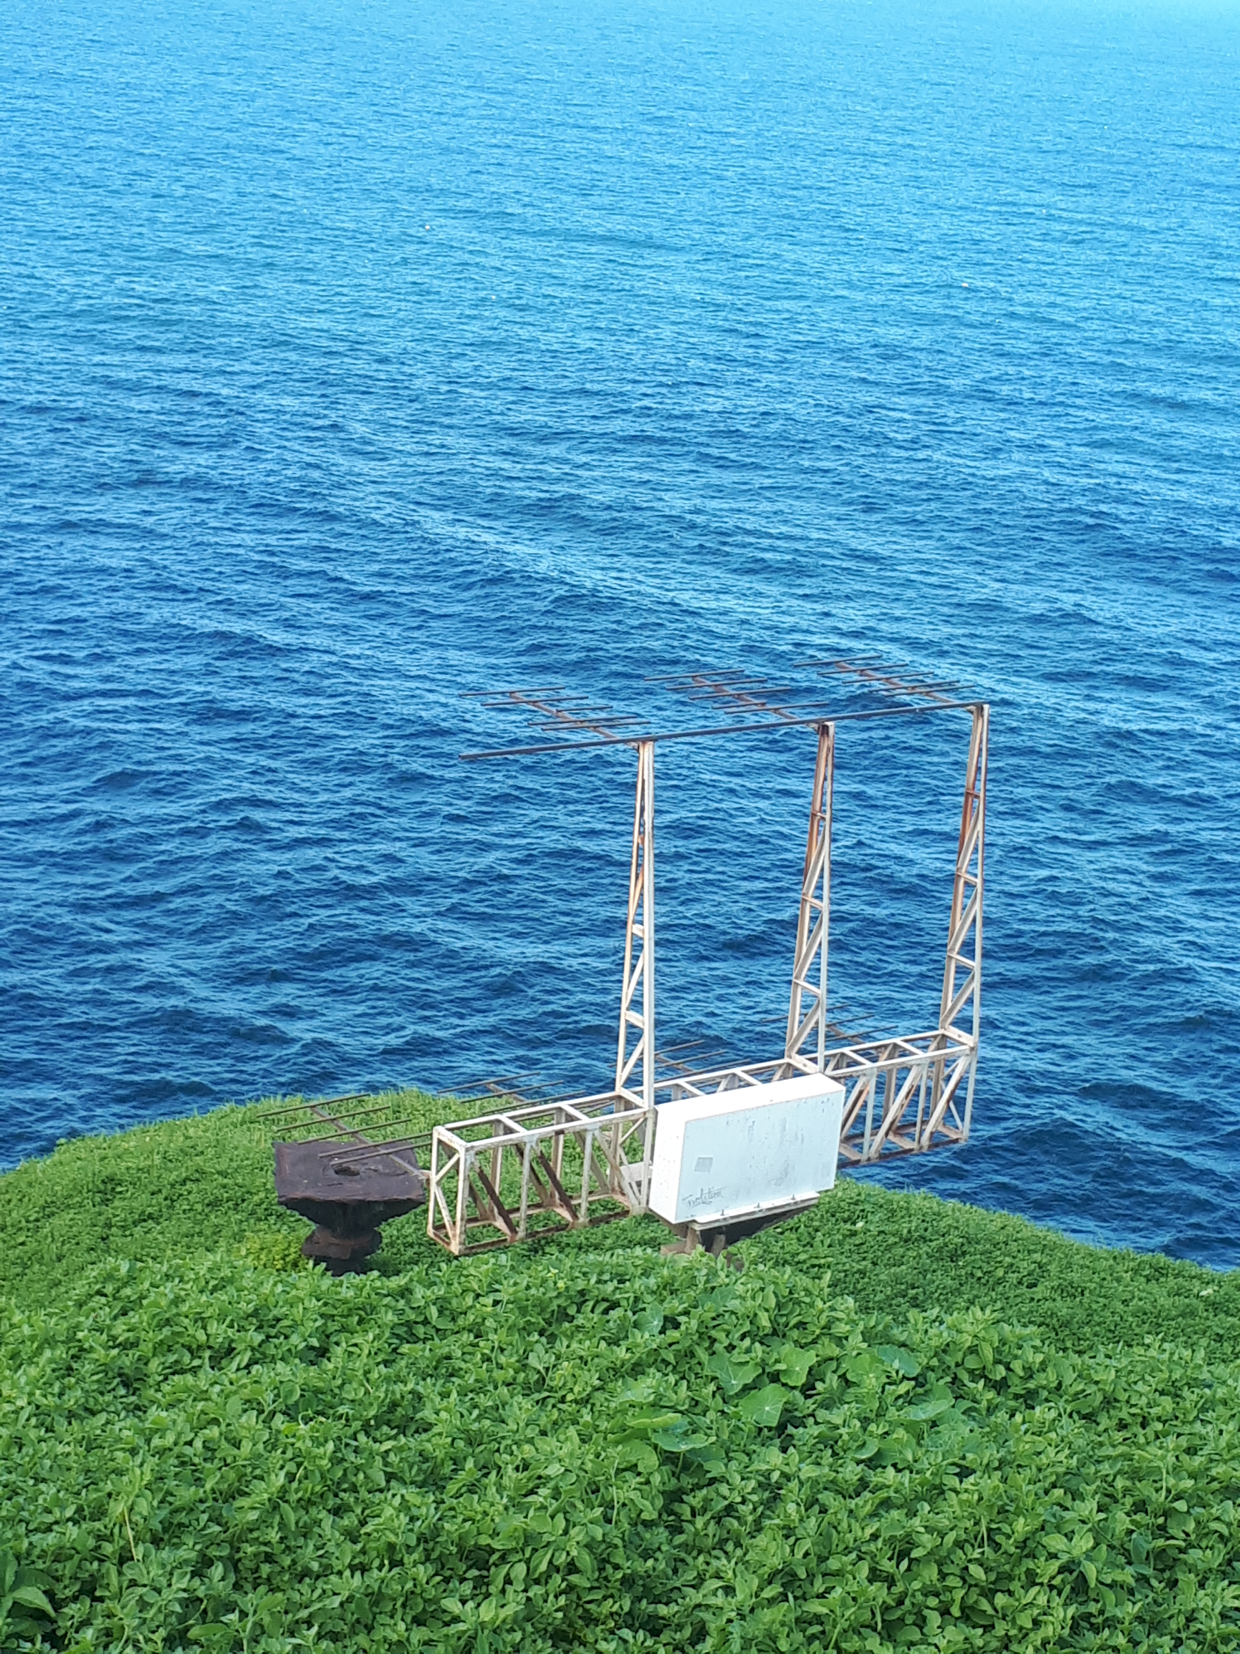
The First Radiotelescopes…
German Würzburg radar, Cambridge
Japanese Yagi radar, Dover Heights, Sydney
Notes:
German and Japanese radars could be modified relatively easily to become receiving instruments. The photo on the right is of a replica Yagi radar and was taken by me in Sydney in March 2022.

Slide 12
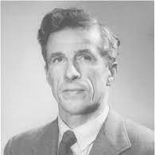
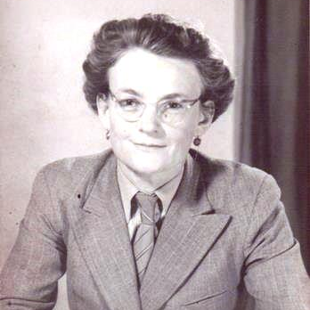
Secret Reports of “cosmic noise”…
1942: a series of recordings of radar jamming in the English Channel came to the attention of a British Air defence Radar physicist, James Stanley Hey.
Hey wrote a classified report suggesting that a mysterious radio noise was coming not from aircraft or signal jamming, but rather from the sun.
1945: Radar operators on Norfolk Island (off the Australian coast) noticed strange bursts of “radio noise” at sunset and sunrise.
Dr Elizabeth Alexander in New Zealand realised that at times of sunspot activity the sun was emitting radio waves.
These classified reports of “cosmic noise” inspired physicists in Britain and Australia to join the race to legitimise a new branch of science: Radio Astronomy
Notes:
JS Hey (1909-2000) was born and grew up in Nelson in Lancashire (the same town as my mother), and studied Physics at Manchester University. His results from 1942 could not be published until after the War. He continued radar and astronomical research and in 1973 published a book called “The Evolution of Radio Astronomy”, one of the first books to put the development of Radio Astronomy into an historical perspective.

Slide 13
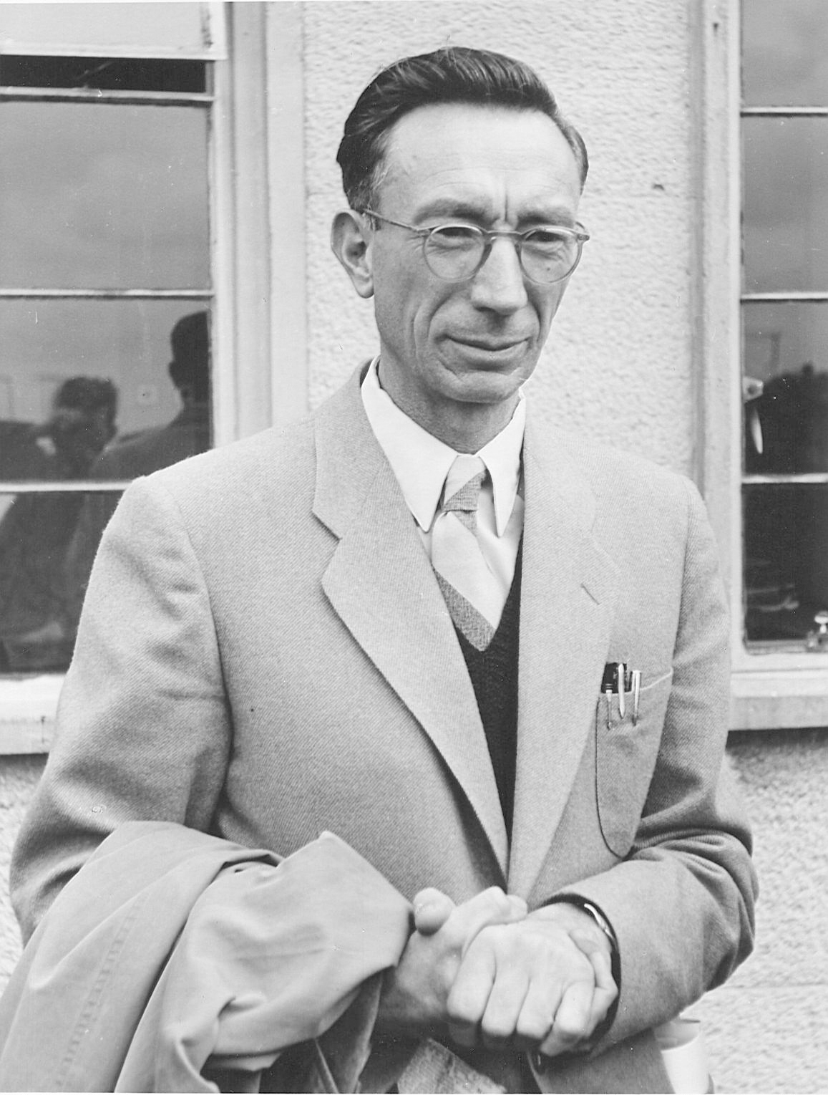
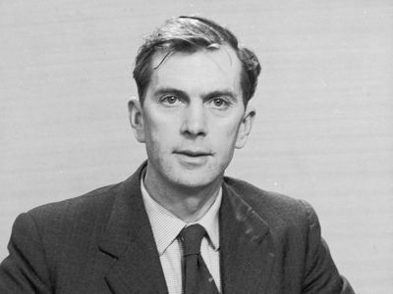
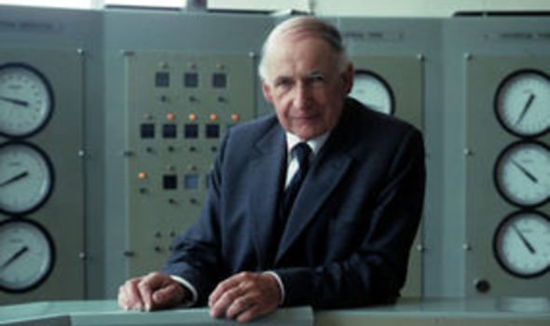
Leading Figures in Radio Astronomy 1945-62
Joe Pawsey, Sydney | Martin Ryle, Cambridge | Bernard Lovell, Manchester
Notes:
In the period 1945-62 these were the three leading figures in Radio Astronomy. During this period Pawsey was widely considered the leader in the field.

Slide 14
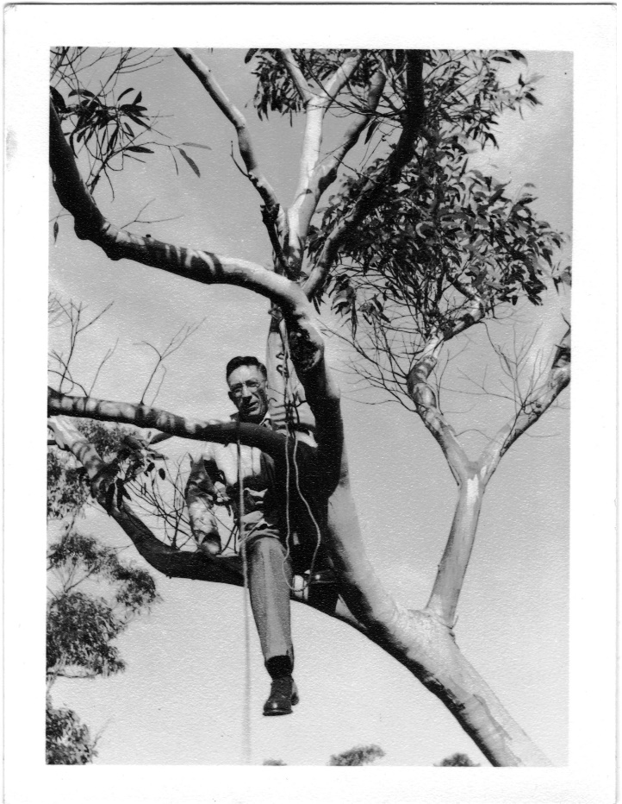
Joe Pawsey (1908-62)
1935
Born in Rural Victoria, scholarships to Melbourne, Cambridge, PhD in ionospheric physics in 1935.
1939
Returned to Australia to head secret work on Radar at CSIRO Radiophysics during WW2.
1945
Conducted one of the first observations of the sun adapting WWII radar at Dover Heights in Sydney.
1948
First person in the world use the term “Radio Astronomy”.
1962
Appointed Head of US National Radio Astronomy Observatory, developed brain tumour; died aged 54.

Slide 15
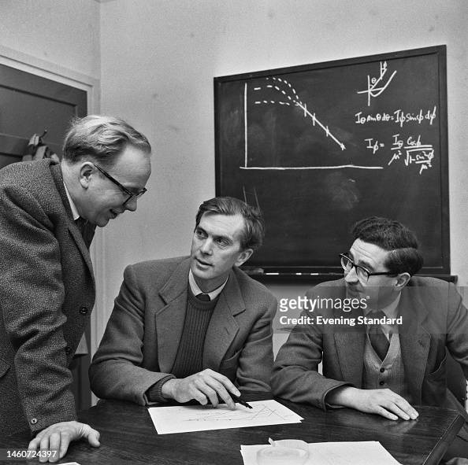
Martin Ryle (1918-84)
1939
Joined TRE aged 21; headed key projects including jamming incoming V2 Rockets and deceiving the Germans as to the D-Day landing site.
1945
Became the leader of the Radio Astronomy group at Cambridge, where he developed a loyal team including Francis Graham-Smith and Antony Hewish.
1947–1948
Pioneer of Aperture Synthesis: Technique used in radio astronomy that mixes signals from a collection of telescopes to produce images having the same resolution as a much larger instrument.
1974
The first Astronomer to win the Nobel Prize for Physics; Knighted in 1966 and Astronomer Royal 1972-82.
Notes:
A couple of close friends attended Bradfield College. I asked them both separately about their Nobel Prize winning alumni, Martin Ryle, and both said “Martin who?” I think this says something both about Ryle’s personality and about the unfortunate place of scientists when compared to sports stars or media personalities. The company I currently work for used to have its head office in Bingley in Yorkshire. The main street is called “Sir Fred Hoyle Way” after its most famous son, who never won a Nobel Prize but had a much higher public profile than Ryle due to his BBC radio talks and popular science books.

Slide 16
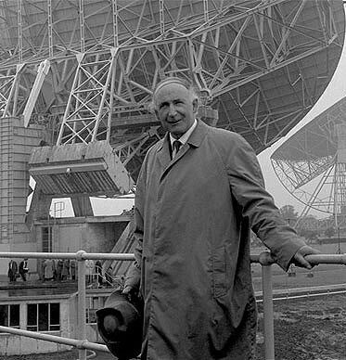
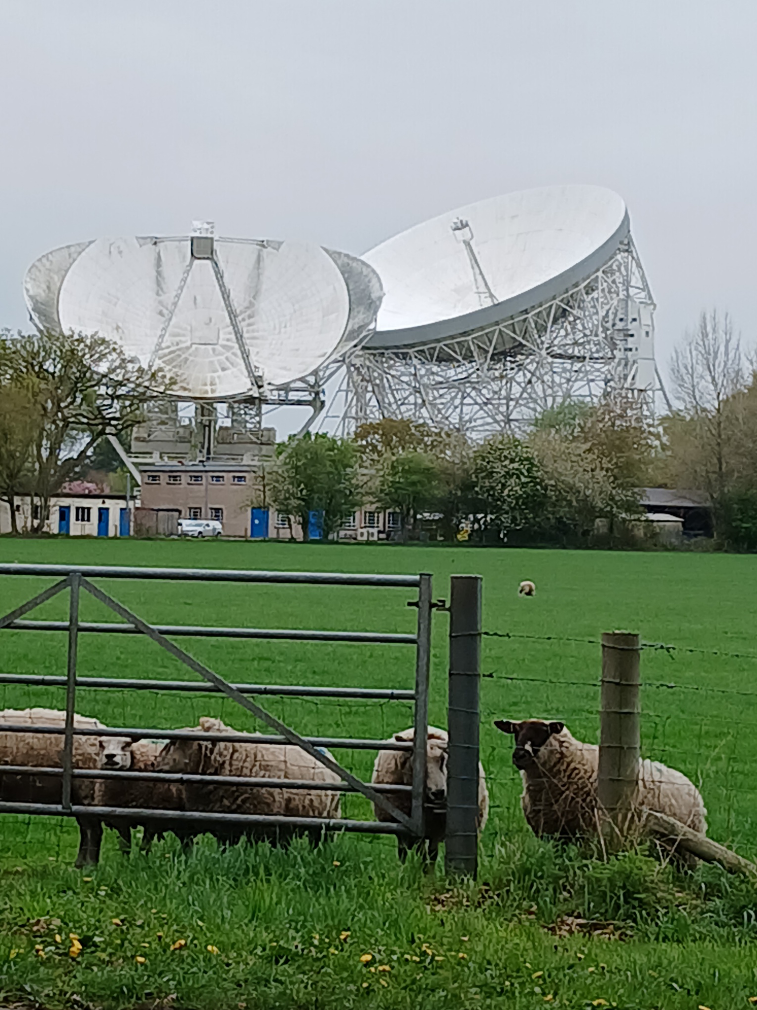
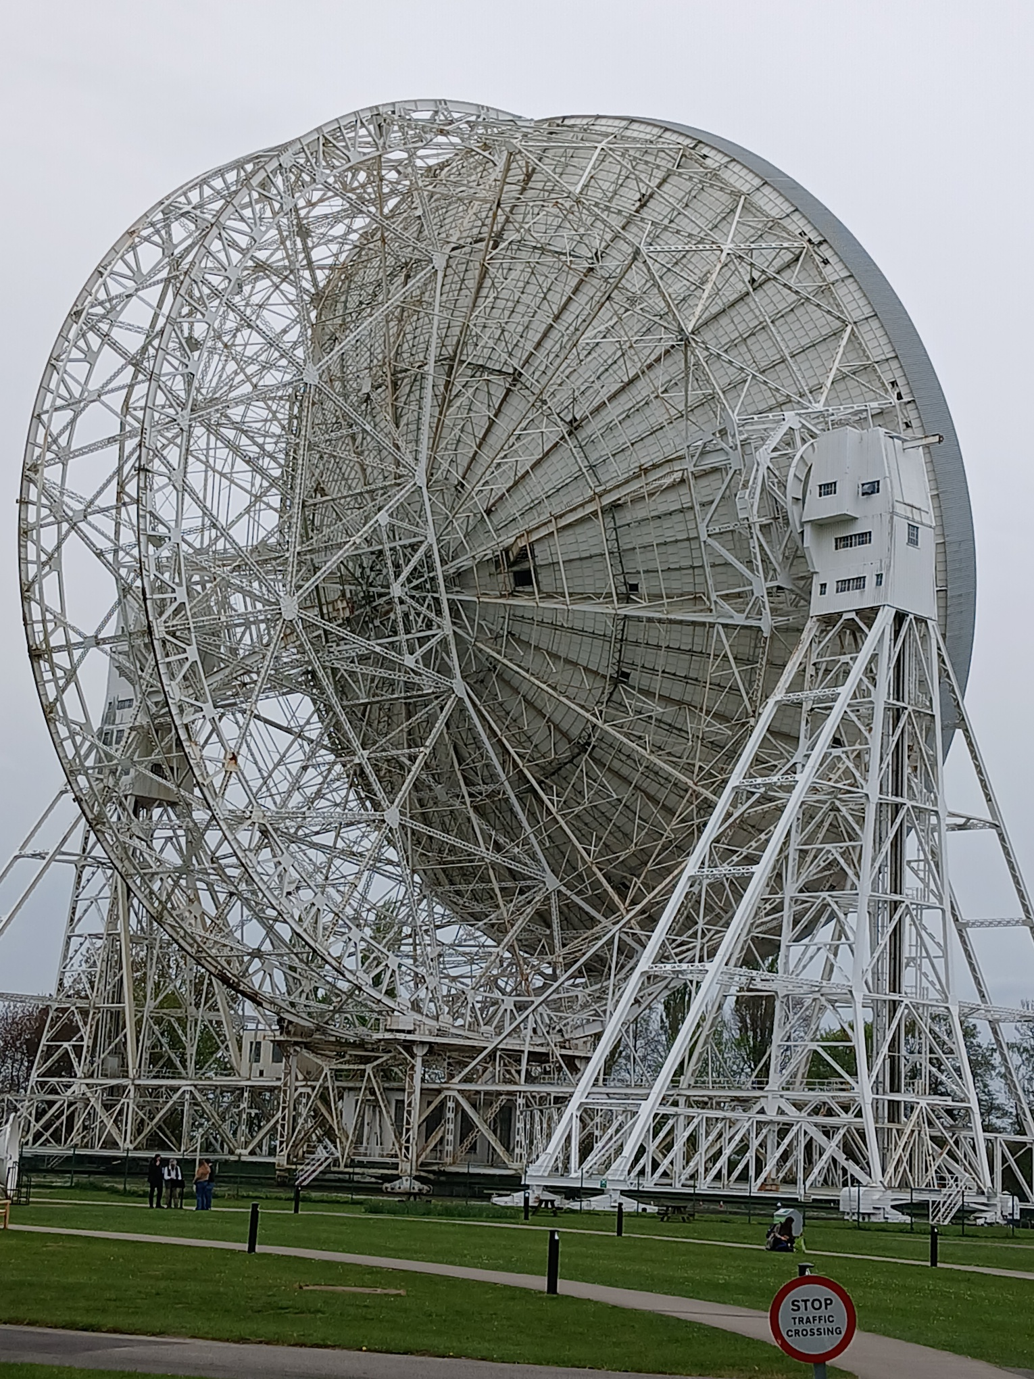
Bernard Lovell (1913-2012)
During WW2 worked for TRE, developing radar systems for aircraft, including H2S, the first airborne, ground scanning radar.
After the War returned to Manchester where he set up the Jodrell Bank Observatory using converted radars.
Completed a 250 foot Lovell Telescope in 1957 and immediately tracked the Russian Sputnik satellite.

Slide 17
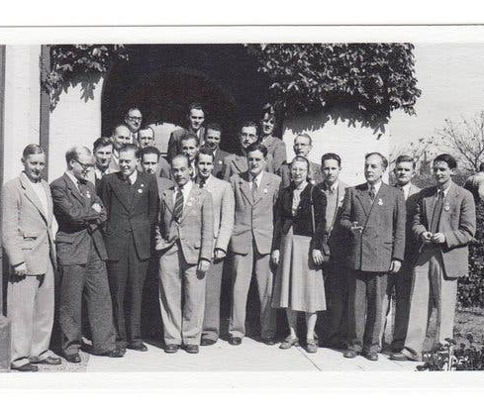
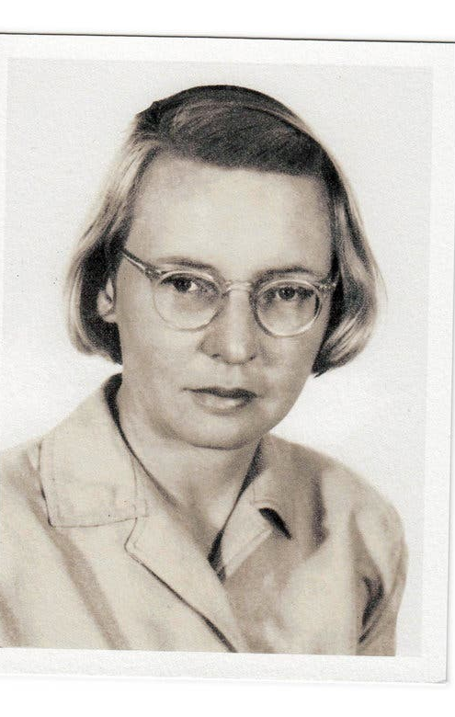
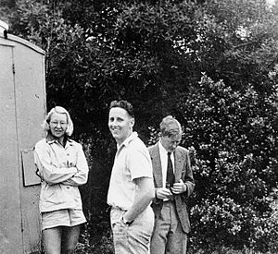
Ruby Payne-Scott (1912-81)
1931-36: Gained 1st Class Hons in Physics and Maths then a Master in Physics.
1938: Only option as a female was to become a science teacher at a girls boarding school.
1941: joined CSIRO Radiophysics, engaging in vital secret wartime radar research.
1945: World’s first female Radio Astronomer
1946: outlined the principles of Aperture Synthesis (before Martin Ryle!)
1951: pregnant and expecting her first child at age 39, she had to leave a promising scientific career to which she never returned.

Slide 18
Early discoveries of Radio Astronomy… that together changed our view of the Universe
1. Million degree Corona (1946, Sydney)
2. Extragalactic nebulae or “Radio Stars” (1948, Sydney)
3. Hydrogen line 21cm (1951, US, Holland & Sydney)
4. Quasars (1962/3 US, UK & Sydney)
5. Cosmic Microwave Background (1965, US)
6. Pulsars….(1967, Cambridge)
Other practical applications of Radio Astronomy:
Sonar; Catscans/MRI imaging; WiFi; Search for Extraterrestial Intelligence (SETI)
Notes:
The centre of the sun is only 5-6,000 degrees so the discovery that the corona (the outer film of the sun) was one million degrees, was a huge surprise.
The 21 cm hydrogen line is a spectral line emitted by hydrogen, the most abundant element in the universe. The 21 cm spectral line appears within the radio spectrum and is thus crucial in Radio observations.
One of the first quasars identified was Quasar 3C 273 by Hazard and Bolton at Parkes made during an occultation of the Moon in 1962.

Slide 19
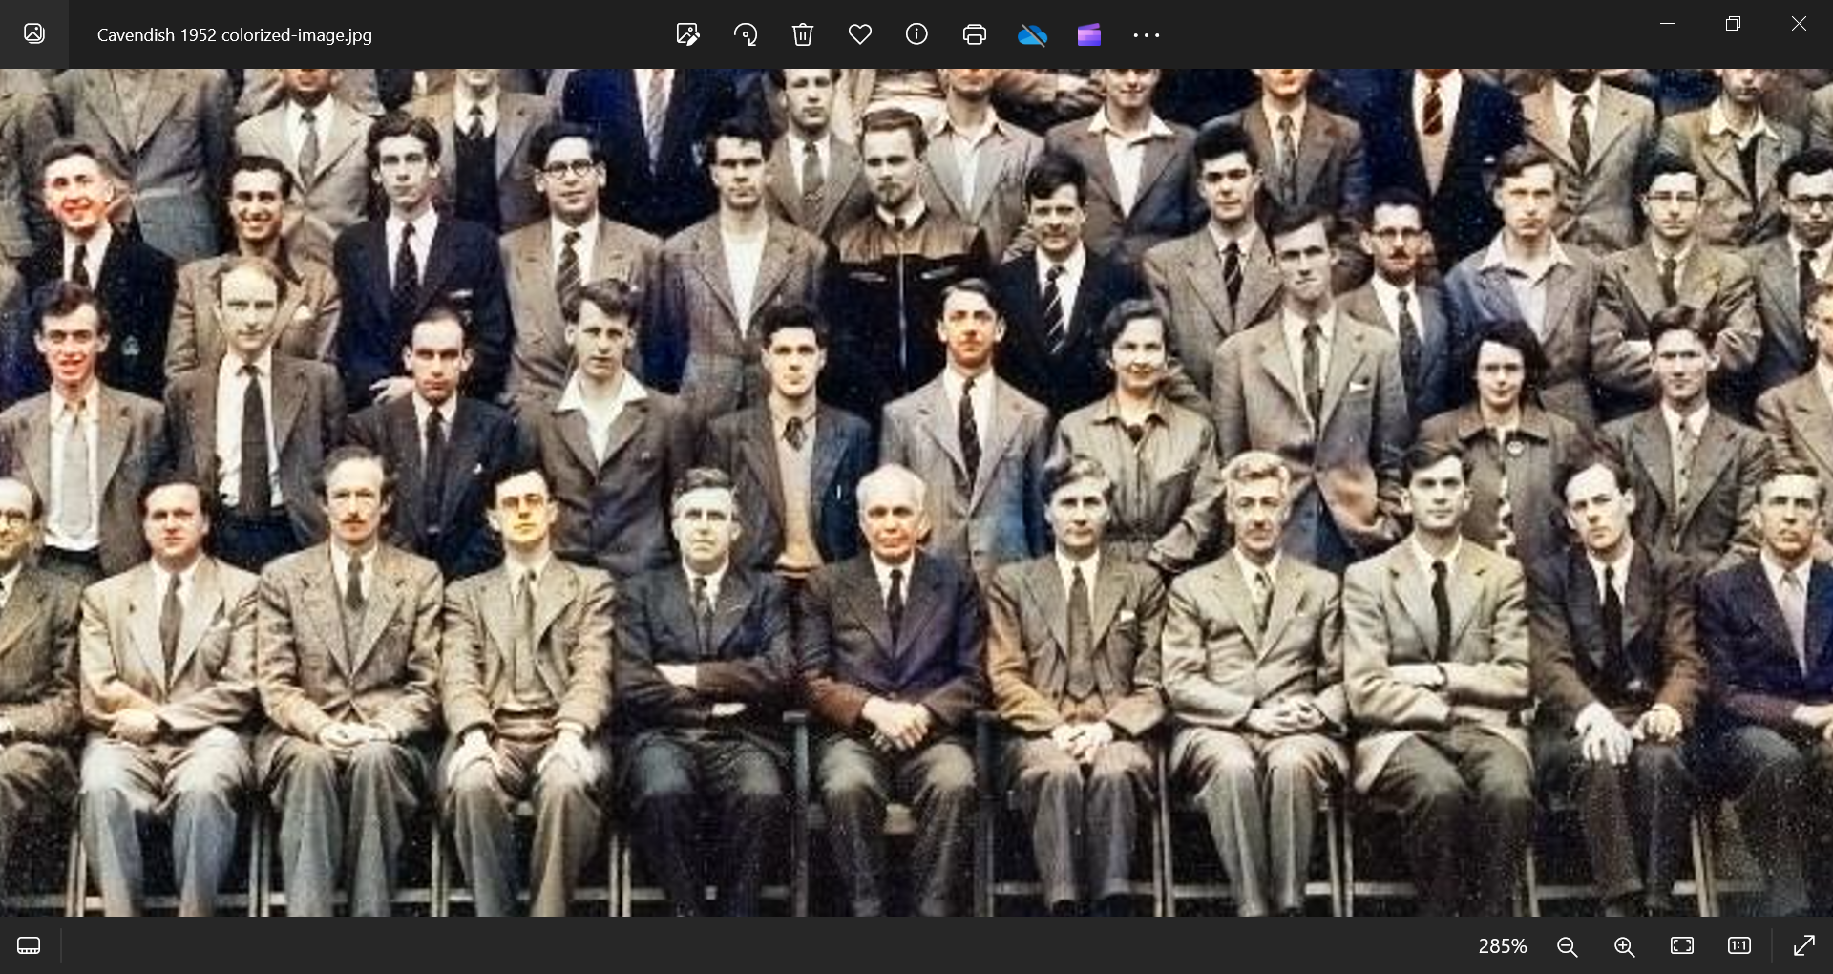
Notes:
This is the annual photo of the Cavendish Laboratory Cambridge taken in June 1952. There are 5 Nobel Prize winners in this photo: Francis Crick & James Watson (1962, DNA); Martin Ryle (1974, Aperture Synthesis); Antony Hewish (1974, Pulsars) and Sir William Lawrence Bragg (1915, X-ray Crystallography). Bragg is the youngest winner of the Nobel Prize for Physics (aged 25) and was Head of the Cavendish from 1938-54. My father is standing next to Francis Crick. He was a PhD student at the Cavendish between 1951-53.

Slide 20
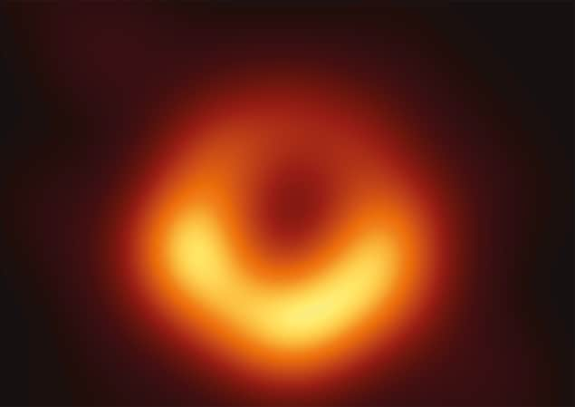
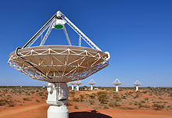
Future of Radio Astronomy
International collaboration is the future.
1. Event Horizon Telescope
April 2019: first direct visual evidence of a black hole revealed by an Array of 8 telescopes around the globe.
The image is of the supermassive black hole that lies at the centre of the Messier 87 galaxy, located 55 million light-years from Earth, with a mass 6.5 billion times that of the Sun.
2. Square Kilometre Array (SKA)
An international consortium of thousands of small Radiotelescopes being built in Western Australia and South Africa, due for completion in 2027.
Its size will make it 50 times more sensitive than any other radio instrument and it is expected to give fresh insights into the early universe.
Notes:
The Global Headquarters of the SKA project is located at Jodrell Bank near Manchester.

Slide 21
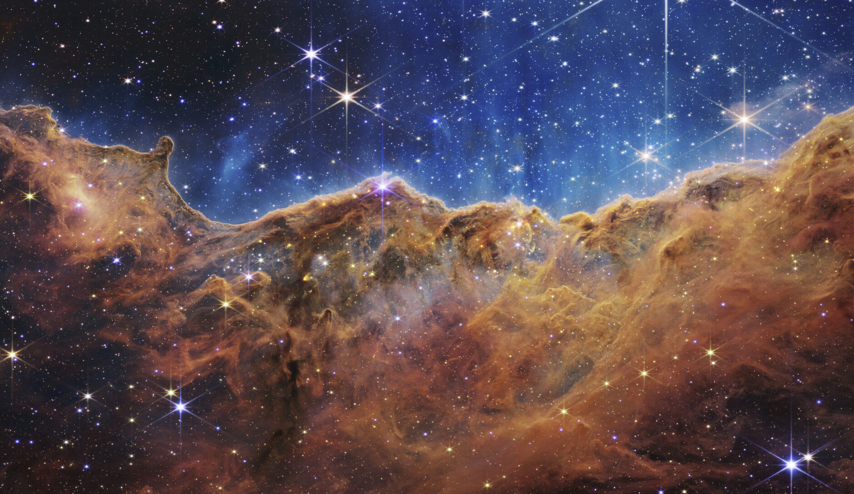
Thank You
Questions?

