Slide 1



Radar Astronomy
Thomas Telkamp, Cees Bassa, Tammo Jan Dijkema, Wolfgang Herrmann, et al.
© 2025 by Stichting Radiotelescoop Dwingeloo and Astropeiler Stockert e.V., licensed under CC BY 4.0.
To view a copy of this license, visit https://creativecommons.org/licenses/by/4.0/

Slide 2
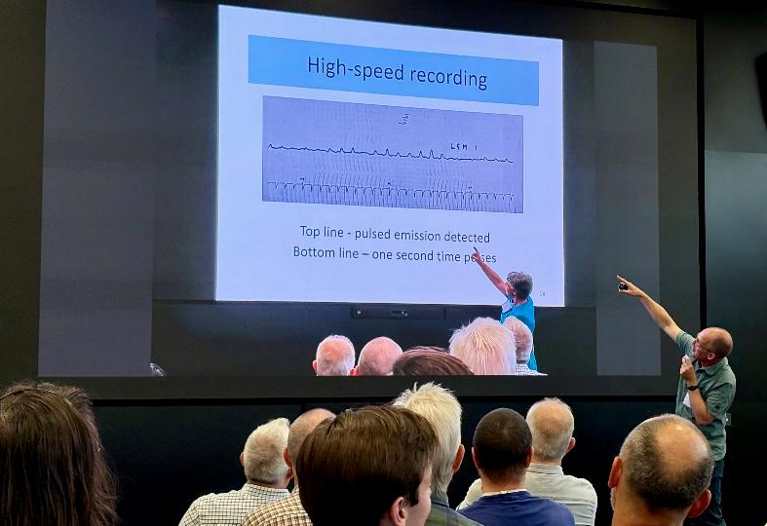

Slide 3
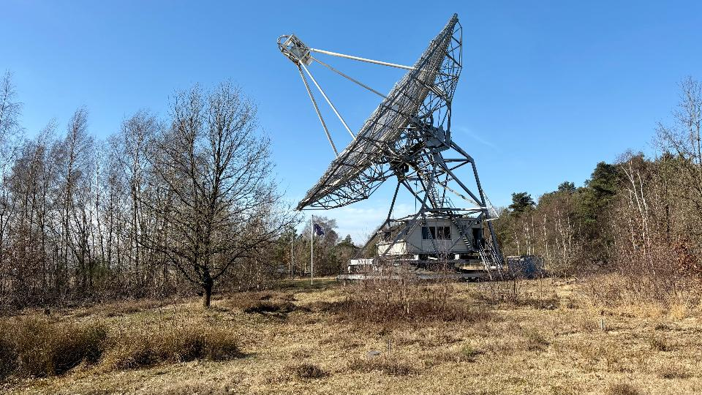
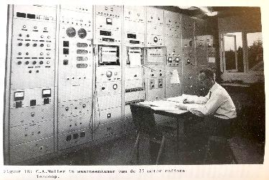

Slide 4
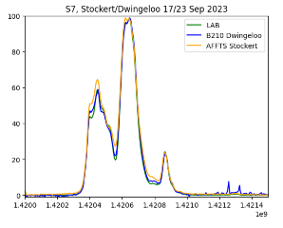
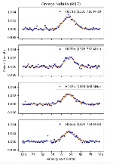
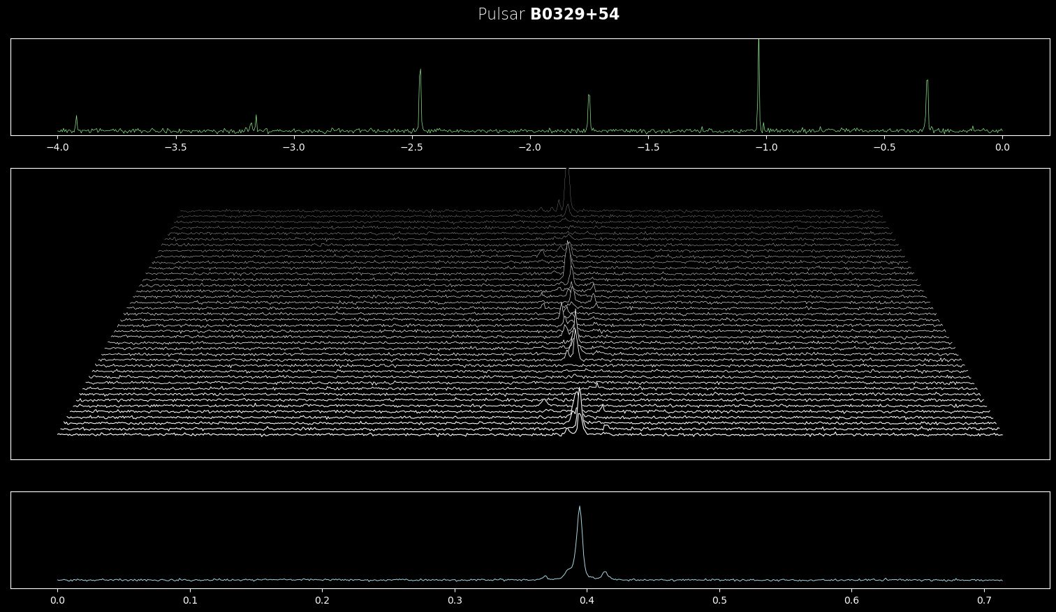
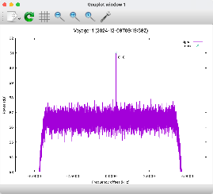
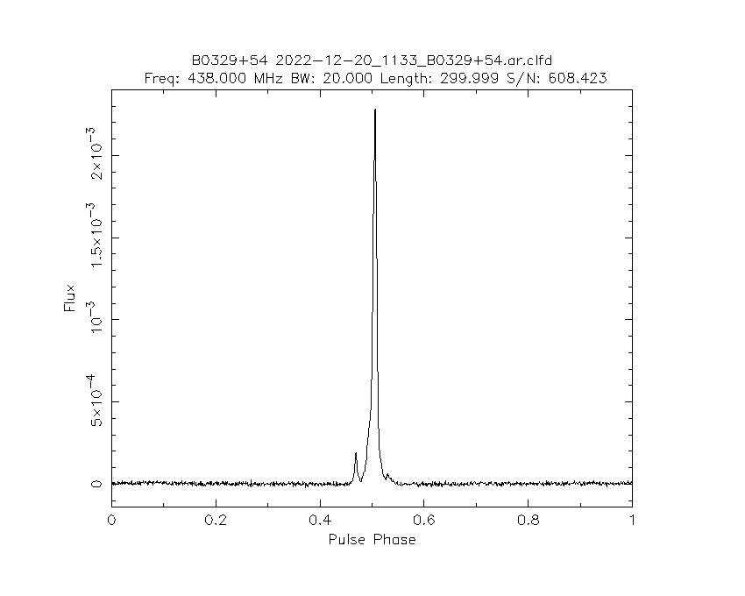
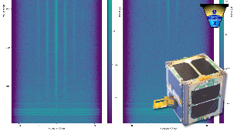

Slide 5
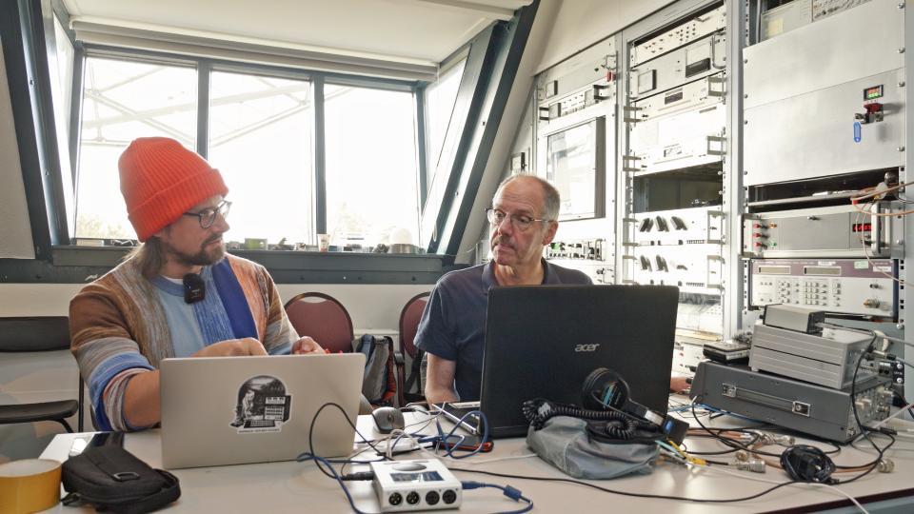

Slide 6
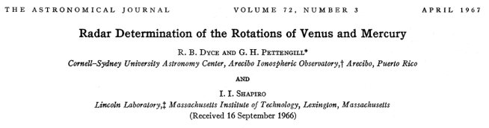
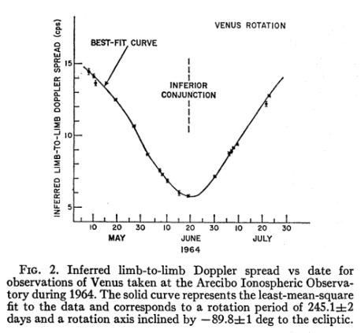
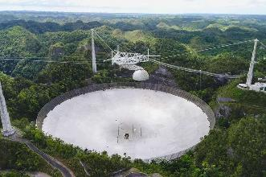

Slide 7
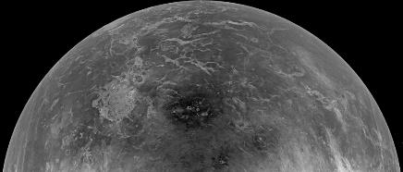
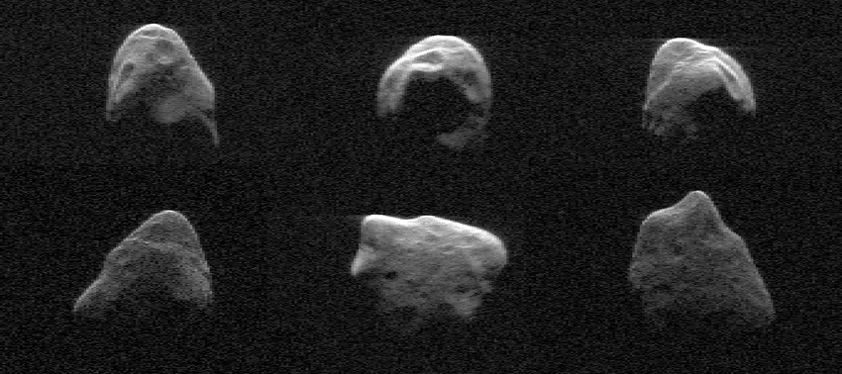
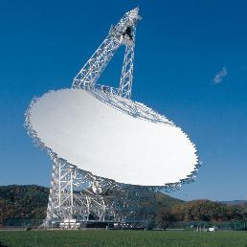


Slide 8
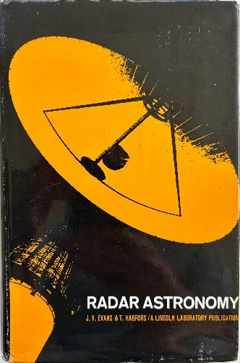
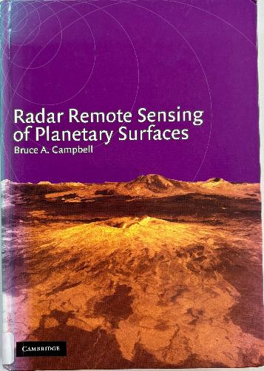

Slide 9
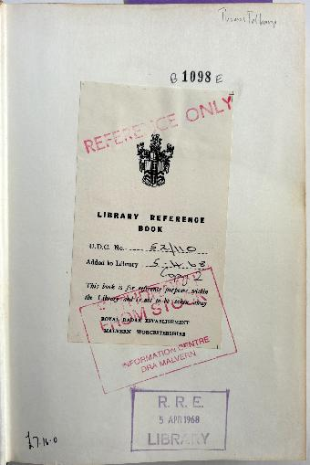

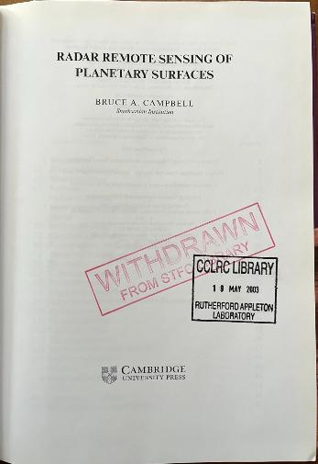
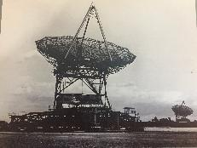


Slide 10
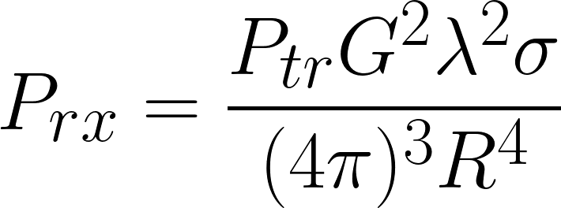
Radar equation

Slide 11

table
cabinet
focus box
50R
23cm RX
23cm RX
to feed
relay
SSPA
120W
23cm TX
to feed
control
DT
sequencer
PA
1299.5 MHz
1W

Slide 12


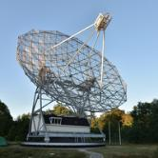
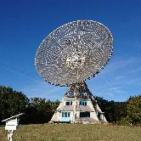
Dwingeloo
Stockert
play_sigmf
usrp_to_vrt
usrp_to_vrt
vrt_to_sigmf
vrt_to_sigmf

Slide 13
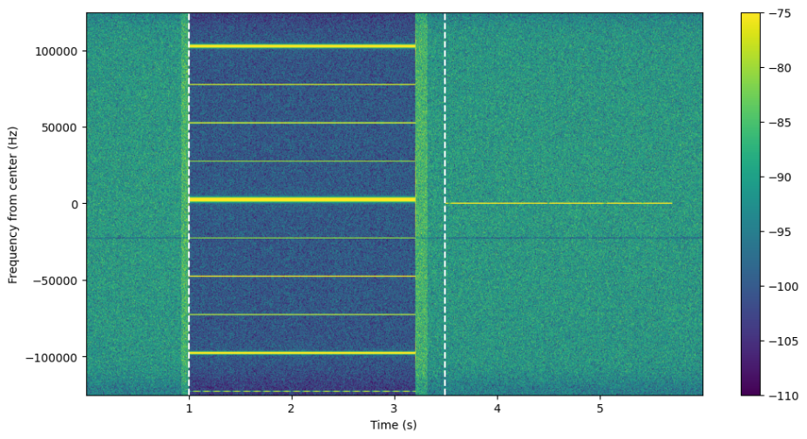

Slide 14
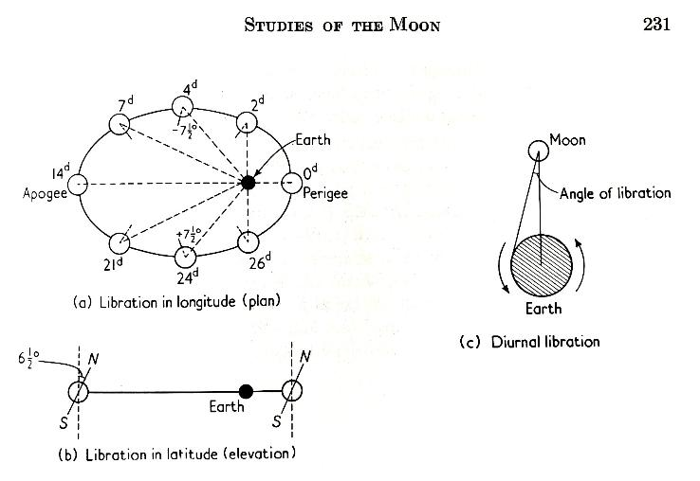

Slide 15
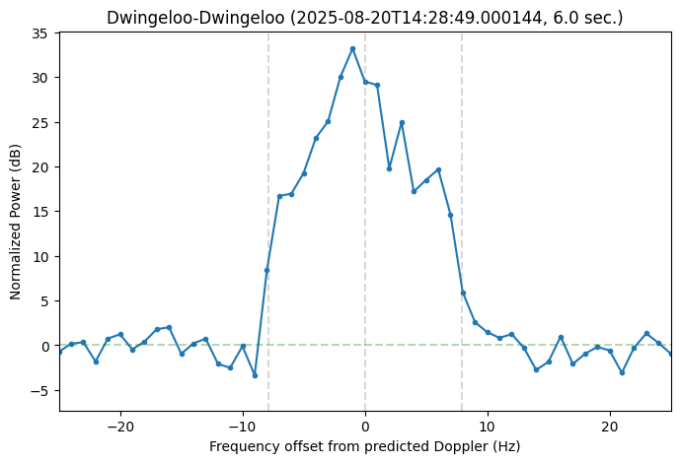
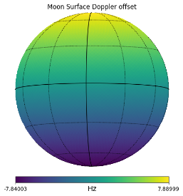

Slide 16
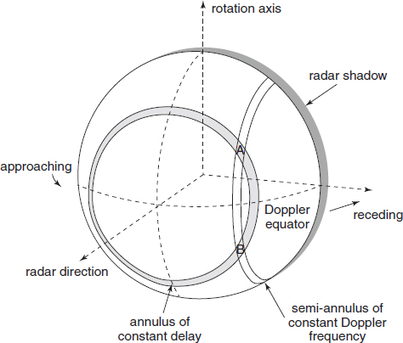

Slide 17
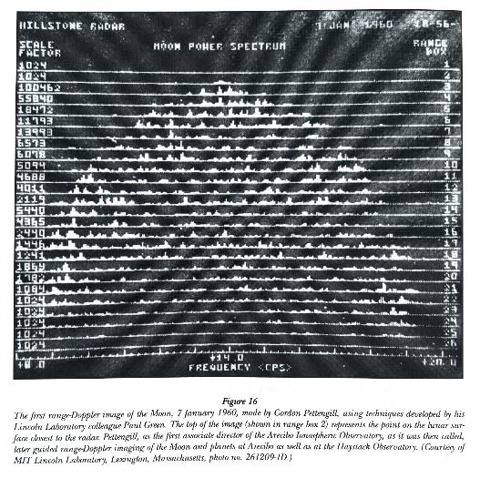

Slide 18
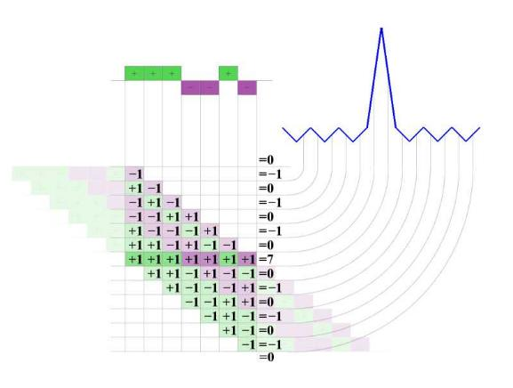
Pulse compression

Slide 19
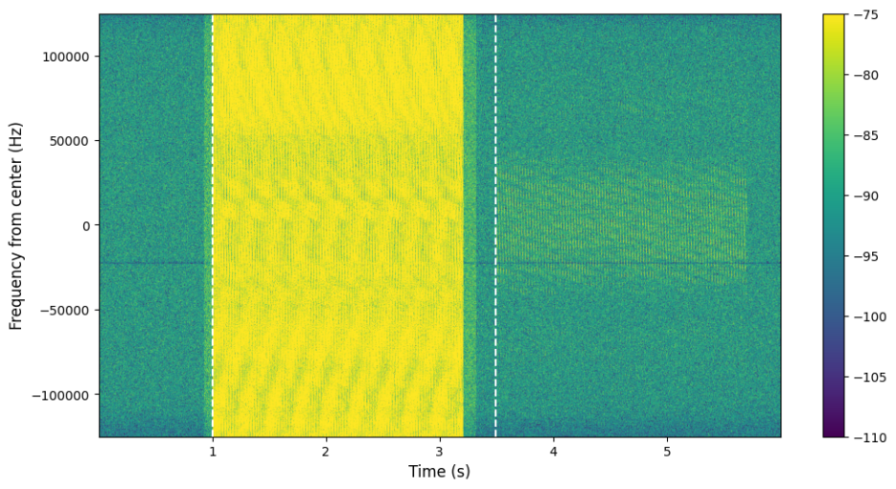

Slide 20
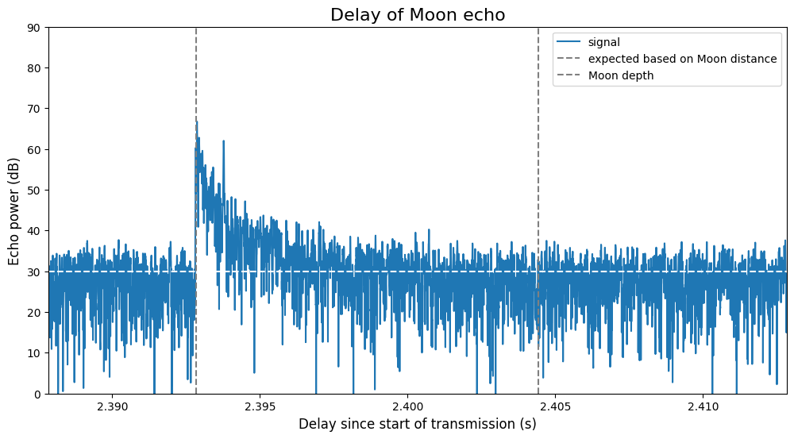

Slide 21
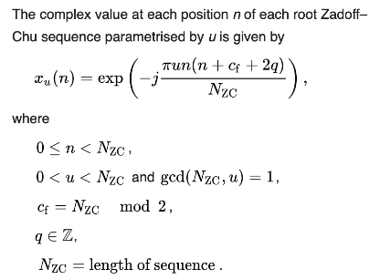
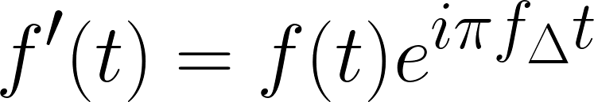
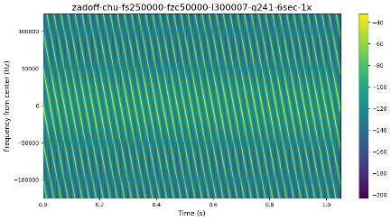
Zadoff-Chu sequence
frequency shift
of complex signal
ambiguity
The auto correlation of a Zadoff–Chu sequence with a cyclically shifted version of
itself is zero, i.e., it is non-zero only at one instant which corresponds to the cyclic shift.

Slide 22

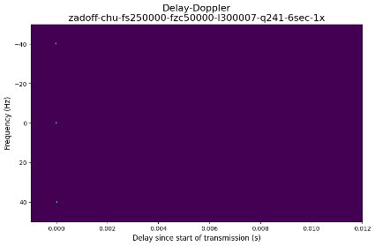
Zadoff-Chu sequence

Slide 23
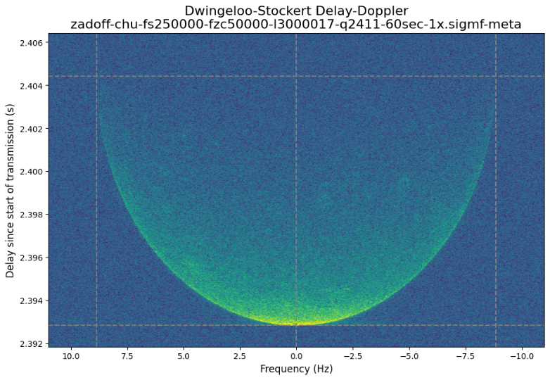

Slide 24
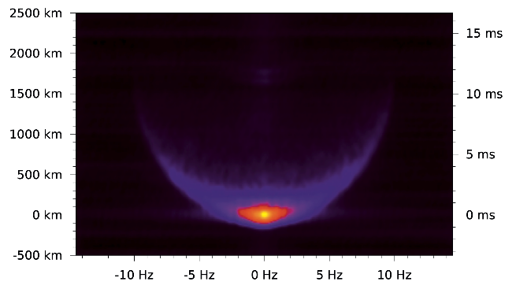
Dwingeloo Delay-Doppler
Pieter-Tjerk de Boer, 2011

Slide 25
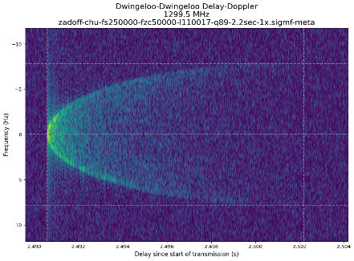
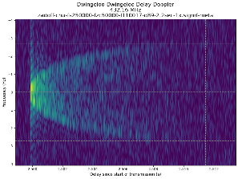
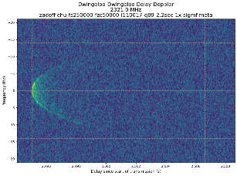
23cm
70cm
13cm

Slide 26

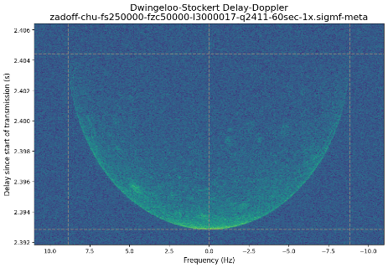
RHCP transmission
LHCP reception
RHCP reception

Slide 27
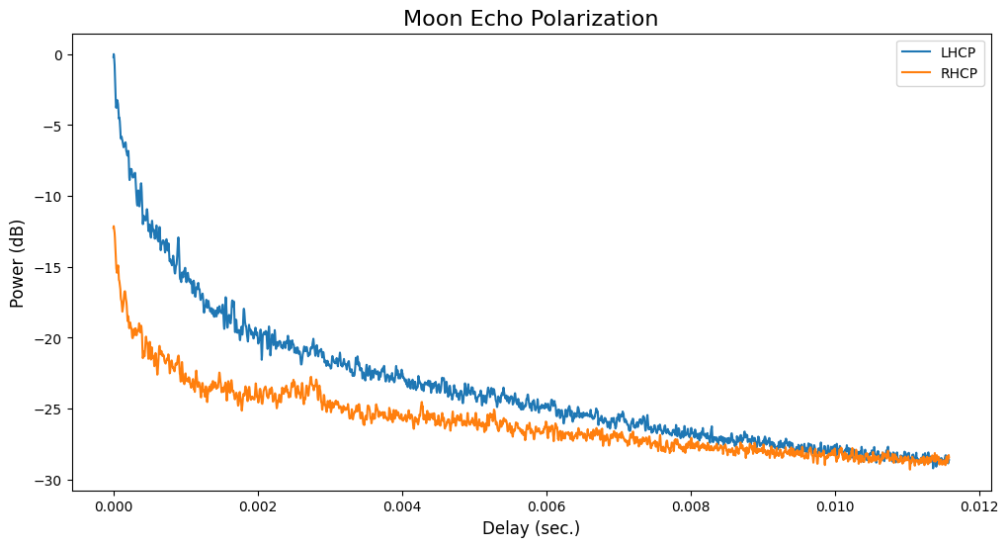
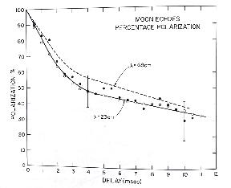
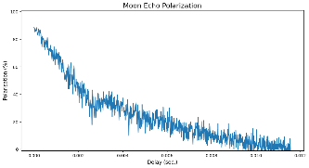

Slide 28
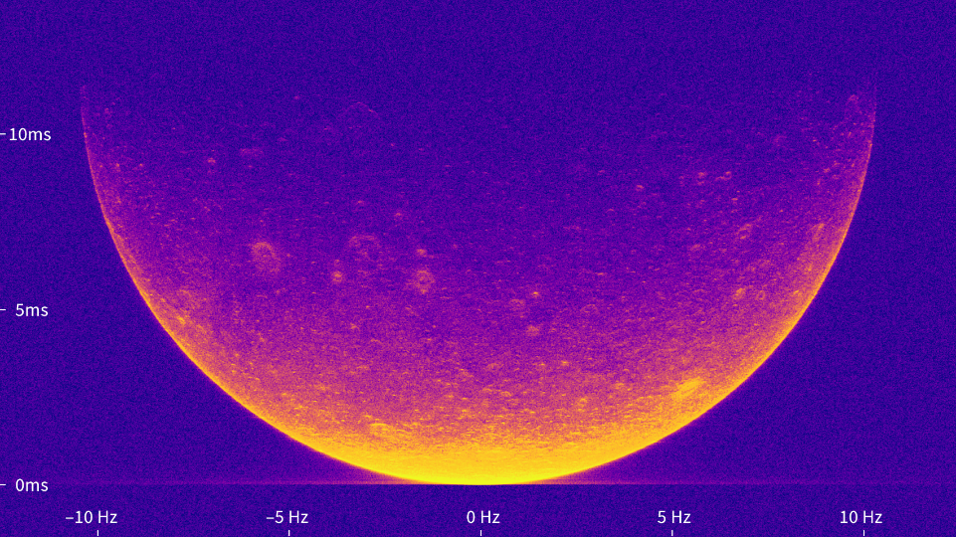
LHCP

Slide 29
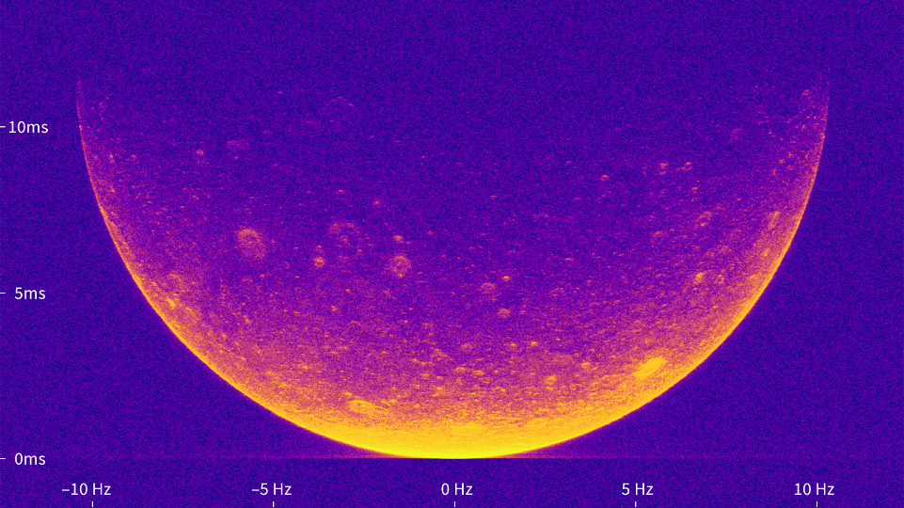
RHCP

Slide 30
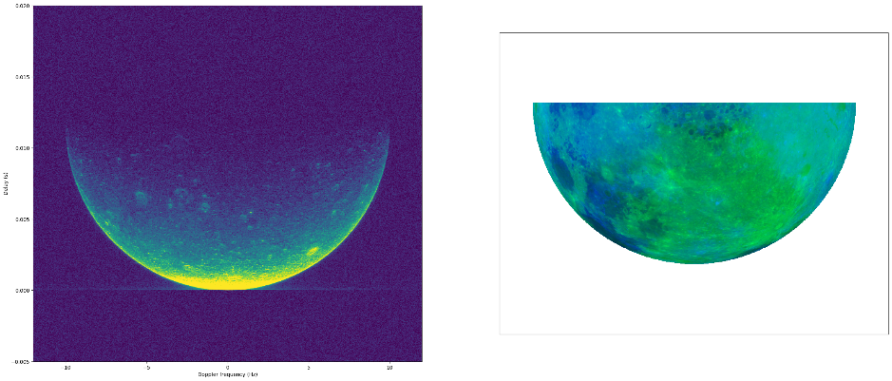
11x 30 sec. Dwingeloo-Stockert

Slide 31
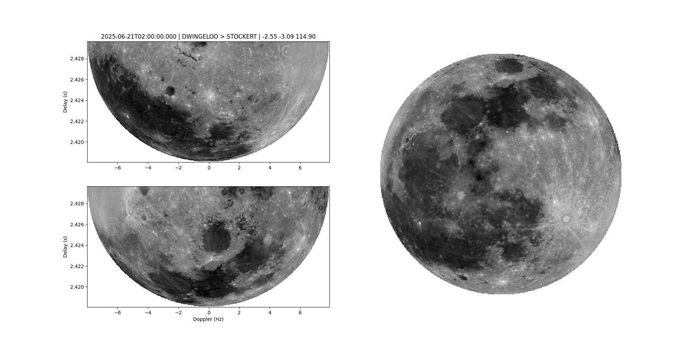

Slide 32


Slide 33

Venus

Slide 34


Slide 35

table
cabinet
focus box
28V power
23cm RX
PE1CKK
control
23cm TX
to feed
DT
sequencer
SSPA 1kW
1W
PA
driver
1299.5 MHz
1W
transverter
ptt
IF 14V/17V
PE1CKK
Power supply
sequencer
IF
open

Slide 36


Slide 37


Slide 38

James Miller G3RUH

Slide 39




SPICE

Slide 40


Slide 41



Slide 42

Transmission schedule
failed

Slide 43


Slide 44

4x 278 seconds CW
Received at Dwingeloo
and Stockert

Slide 45

4x 278 seconds CW
Averaged
Received at Dwingeloo
and Stockert

Slide 46


Slide 47



Slide 48


Slide 49

X

Slide 50
Acknowledgements
Teams at Dwingeloo and Stockert!
Jan van Muijlwijk
Daniel Estévez
Pete Wyckoff
Nathaniel Fairfield

Slide 51


Slide 52


